Slide 1
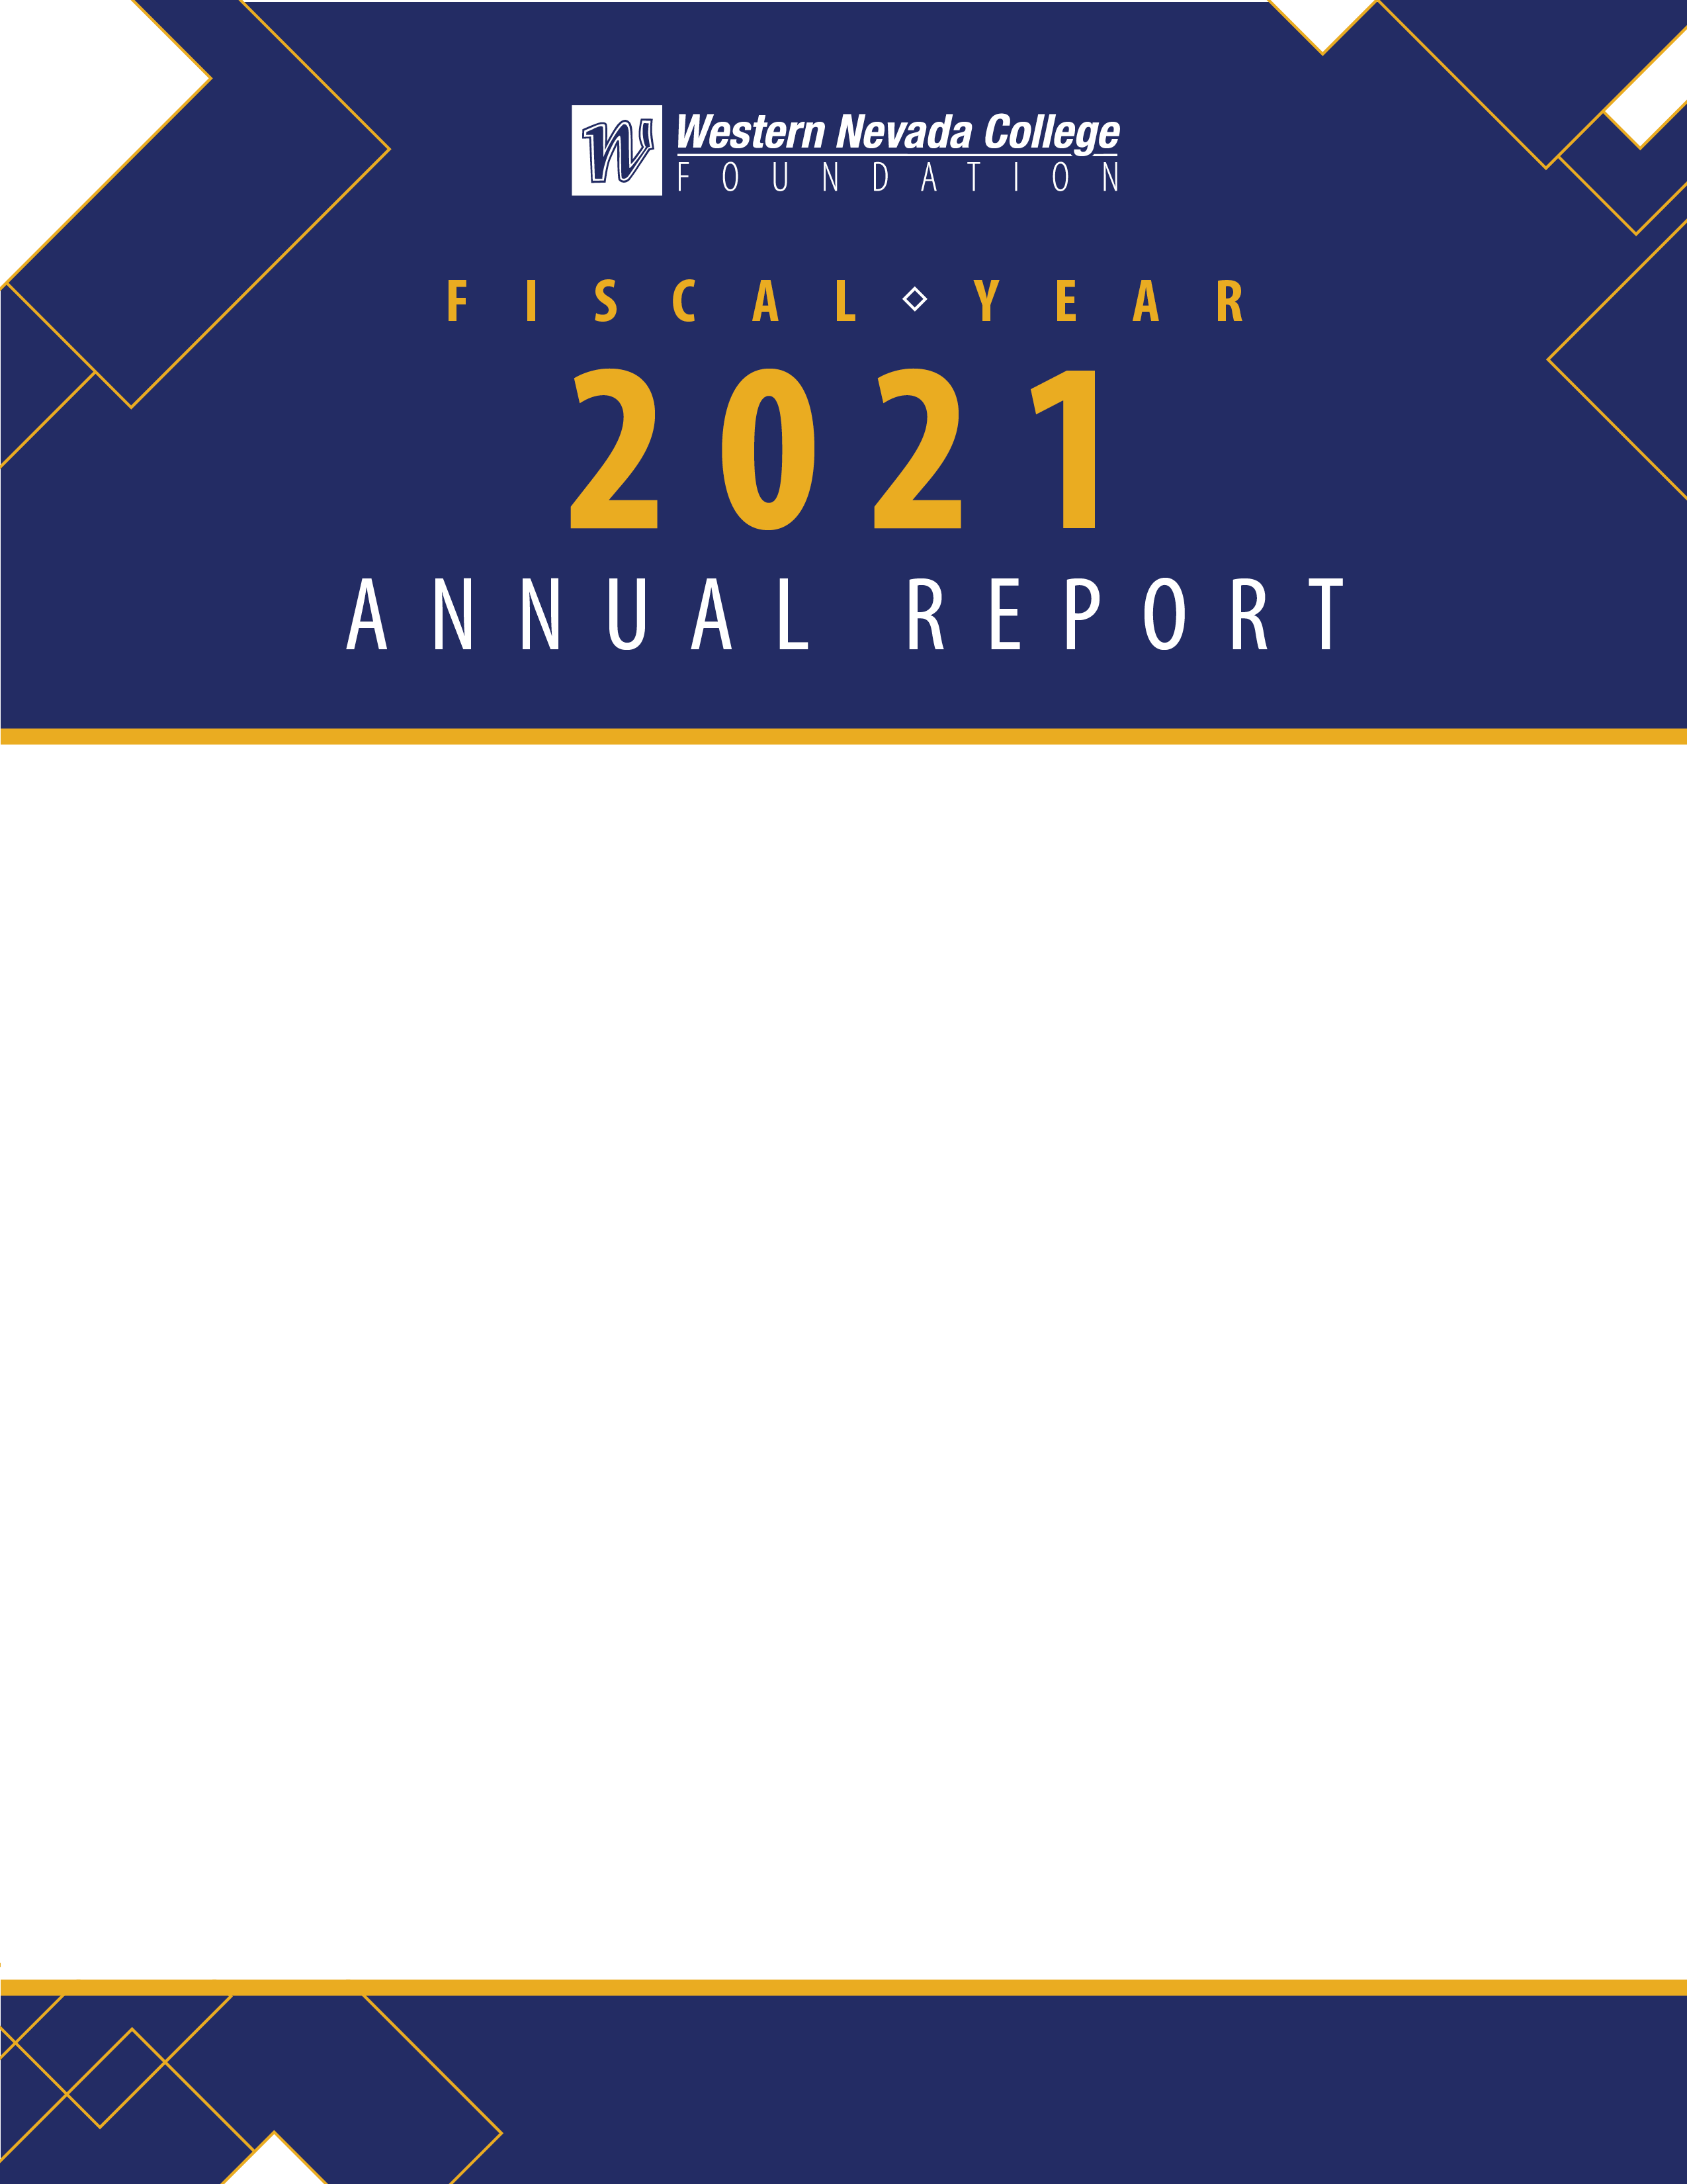
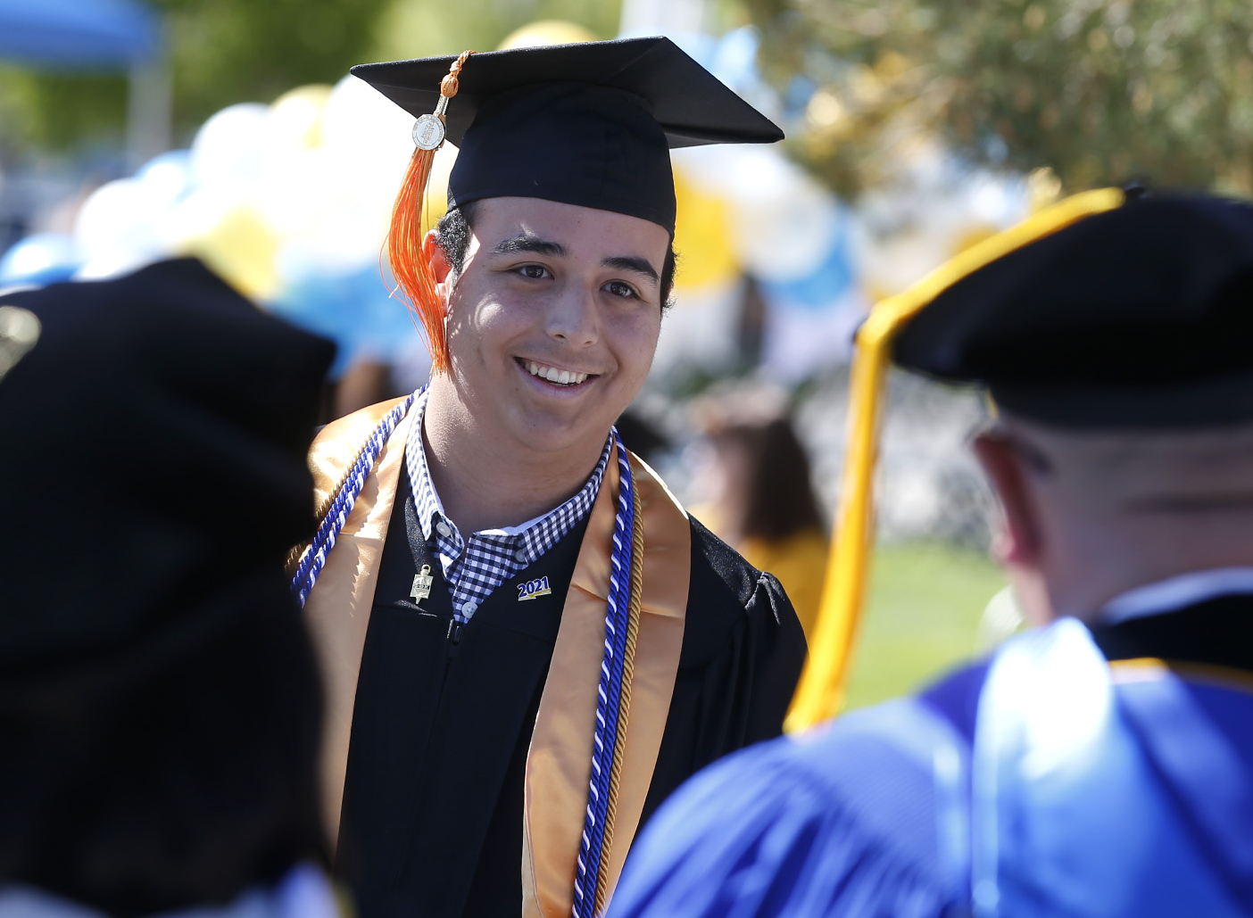
Prepared for Nevada System of Higher Education Board of Regents
Presented on December 3, 2021 by Sean Davison, Chair, WNC Foundation and
Niki Gladys, Executive Director, WNC Foundation

Slide 2
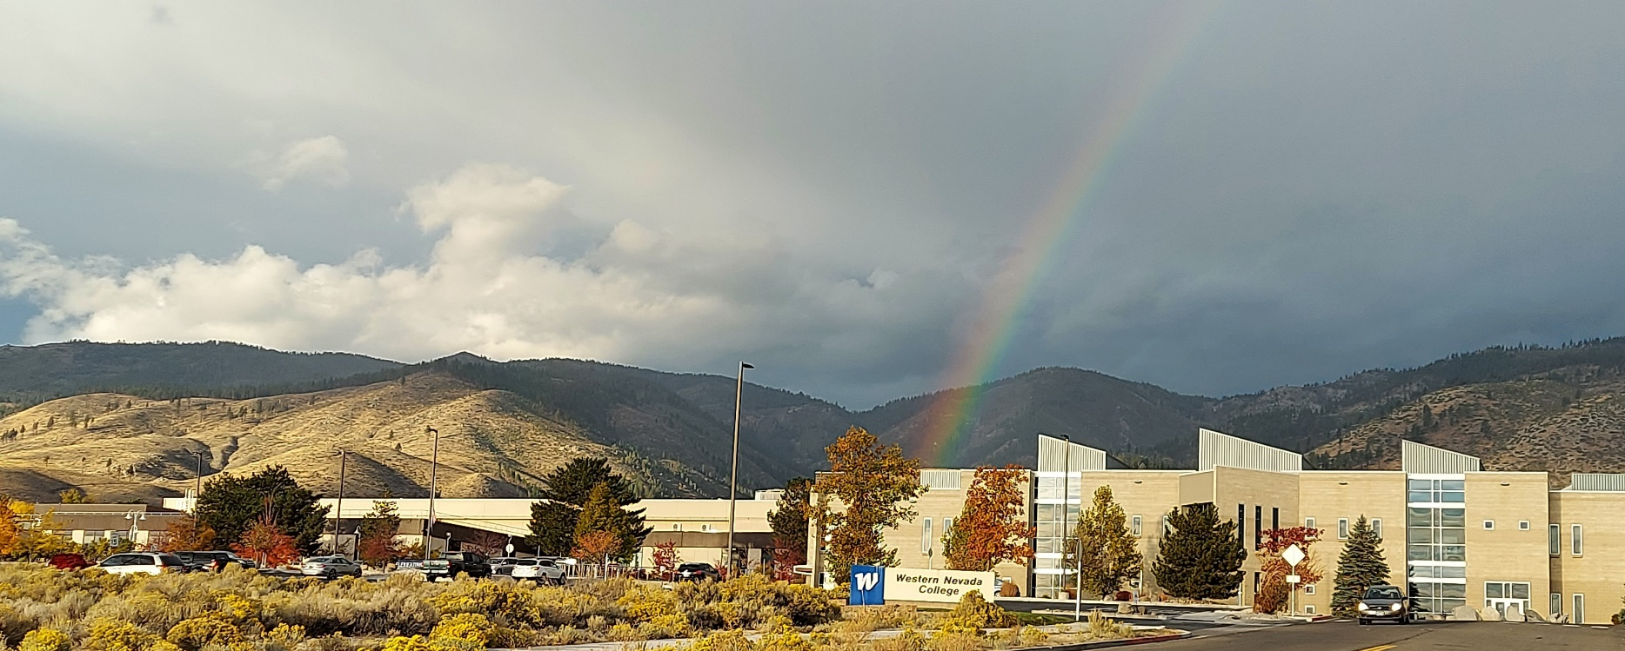
WNC Foundation Mission
WNC Foundation develops resources in support of Western Nevada College by creating community partnerships, encouraging philanthropy and strengthening the relationships between the college and communities it serves.
WNC Foundation Pledge
The WNC Foundation is committed to ensuring donors can invest in students, programs and facilities with confidence and ease. WNC Foundation performs due diligence of fund management, maintains compliance with IRS guidelines and responds rapidly to all inquiries. Investments through the WNC Foundation help to create opportunities – chief among them, employment. Investments support students as they earn an education and obtain jobs, allowing them to support their families, build their careers and contribute back to their community.

Slide 3

Gift Report
A total of $2,338,222.25 in cash gifts were raised from individuals, corporations and foundations for the year ending June 30, 2021 (FY21). An additional $6,650.70 of in-kind gifts were raised including an Ambulance donated by Metro West Ambulance to help support WNC’s new Paramedicine program. The donated vehicle is valued at over $7,500.
Sources of Giving FY20 Giving History
Grants $507,000
Individual Donors $631,189
Events $164,600
Corporations $76,641
Svc Org./Others $73,831
Employee Giving $16,701
*USDA Grant $464,583
FY12 $404,932
FY13 $431,868
FY14 $360,738
FY15 $461,796
FY16 $389,396
FY17 $1,928,133
FY18 $538,189
FY19 $2,477,546
FY20 $1,469,963
*WNC was awarded $464,583 from the USDA's Rural Utilities Service's Distance Learning and Telemedicine Loan and Grant Program. The college raised $70,000 in matching funds, with $40,067 of the funds awarded by The William N. Pennington Foundation. The grant supports greater distance learning instruction across the service area. This grant does not flow through the WNC Foundation's financials.
FY21 $2,338,222.25

Slide 4
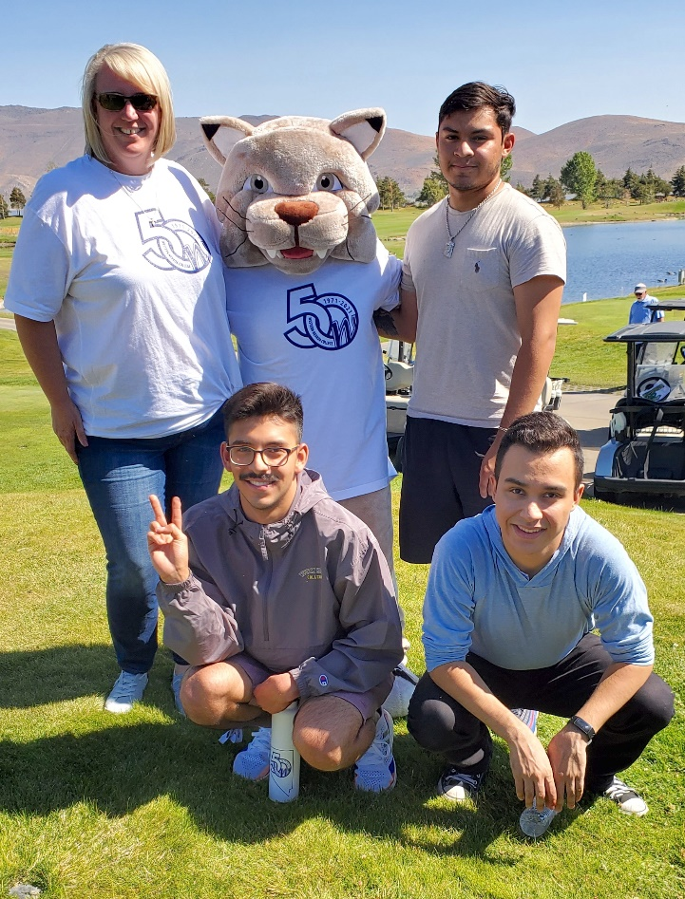
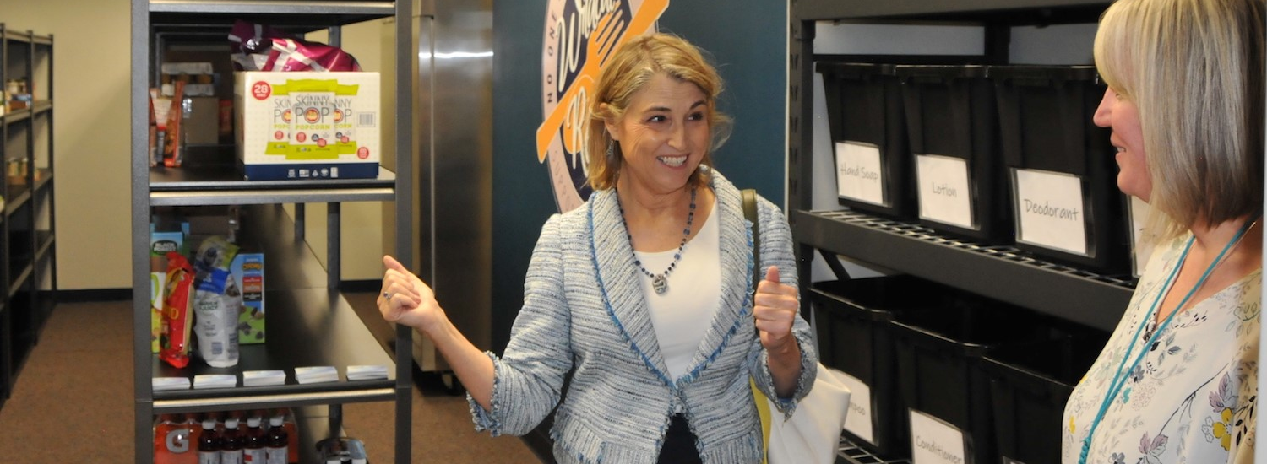
FY21 Investment in WNC (By Initiative)
The WNC Foundation was pleased to support WNC students, programs and facilities throughout the 2020-2021 academic year. Despite challenges brought on by the pandemic, WNC Foundation was able to provide over a million dollars in support to the college.
Biology Laboratory | $157,375
Fallon Science Lab | $130,235
Scholarship Support | $648,049
Prison Education Scholarship Support | $26,636
Food Pantry | $20,000
Performing Arts | $20,000
Library | $15,000
Nursing | $11,788
Emergency Student Technology | $10,000
Misc Support | $44,380
Total Contributions $1,063,463
Below: Kate Marshall visits WNC’s food pantry. WNC is committed to fighting hunger and food insecurity by offering a variety of non-perishable food and hygiene items through Wildcat Reserve. Generous financial support from NV Energy, Visiting Angels, Carson City, soroptimists, the Denzla family and University Police Services helped fund the reserve through WNC Foundation.

Slide 5
WNC Foundation’s History
of Investment in WNC
WNC Foundation assisted Western Nevada College by securing funding to support the following capital projects throughout FY21.
Following a recent survey to better understand student food and housing insecurity, WNC Foundation secured funding for a Food Pantry that will supply nonperishable toiletries and groceries to students in need. This initiative has been funded through a grant from NV Energy, a donation from Visiting Angels, through a generous gift from WNC’s campus police, and several private donations as well as grants from soroptimists and Carson City.
In an effort to continue to improve student experiences, a $941,244 capital project was initiated to renovate and expand the Biology/Chemistry Lab and create an HVAC Lab at the WNC Fallon campus. This project was made possible through the generosity of the William N. Pennington Foundation and will be completed in 2022. This lab had not been updated since 1992 and will facilitate 21st century learning, featuring state-of-the-art technology and lab design while increasing WNC’s capacity to serve students.
WNC Foundation raised close to $800,000 to build a mobile manufacturing Training Unit to impact workforce development by training rural students on manufacturing practices. WNC secured grant funding from William N. Pennington Foundation, Tesla, Wells Fargo and WINN through the Governor’s Office of Economic Development to support this innovative project.
FY12 $184,384
FY13 $319,439
FY14 $207,290
FY15 $584,303
FY16 $430,615
FY17 $366,632
FY18 $1,813,397
FY19 $889,065
FY20 $2,115,465
FY21 $1,063,463
$1,813,397
$2,115,465
$1,063,463
$584,303
$889,065
$184,384
$319,439
$207,290
$430,615
$366,632

Slide 6

Financial Performance
The WNC Foundation assets totaled $6,717,419 as of June 30, 2021. This compares to assets of $4,545,500 one year prior. The 48% increase is due, in part, to the $941,244 grant from the William N. Pennington Foundation for the renovation of the Fallon Biology Laboratory to be completed in the spring of 2022.
WNC Foundation Total Assets
FY10 $2,500,942
FY11 $2,732,356
FY12 $2,861,144
FY13 $2,952,127
FY14 $3,186,479
FY15 $3,019,868
FY16 $2,916,805
FY17 $4,602,644
FY18 $3,468,662
FY19 $5,201,498
FY20 $4,545,500
FY21 $6,717,419

Slide 7
FY21 Student Scholarship Support
WNC Foundation was pleased to award our highest dollar amount of scholarships in the history of the foundation with a 30% year-over-year increase for the 2019-2020 academic year.
501 scholarships were awarded to 403 students, a 62% growth compared to FY20.
$200,000 in scholarship support was generously provided by the William N. Pennington Foundation for the benefit of 120 students pursuing careers in technical education.
Nursing scholarships grew to over $190,000 in annual funding.
The Industrial Arts Workforce Development Scholarship was established following a generous $100,000 donation thanks to Ron Turek and Ann Carlson.
The Drs. Sandra Koch and Tim McFarren STEM Scholarship was established through the endowment created within the WNC Foundation thanks to the generous $100,000 donation from Drs. Sandra Koch and Tim McFarren.
In addition, the WNC Foundation is forecasting that more than $700,000 will be awarded for the coming academic year as fundraising efforts have resulted in the establishment of 10 new scholarships that will be awarded in the FY 21-22.
FY11 $125,800
FY12 $92,350
FY13 $122,527
FY14 $160,263
FY15 $156,128
FY16 $169,440
FY17 $204,210
FY18 $256,046
FY19 $435,464
FY20 $547,048
FY21 $674,685

Slide 8

FY20 Event Revenue: Reach for the Stars & Golf for Education
Year Revenue Profit
FY11 $17,460 $9,428
FY12 $0 $0
FY13 $18,496 $11,663
FY14 $14,573 $7,139
FY15 $0 $0
FY16 $16,912 $11,069
FY17 $50,578 $24,492
FY18 $53,580 $27,958
FY19 $115,645 $69,310
FY20 $159,153 $100,216
FY21 *$46,716
* Reach for the Stars was not held in FY21 due to event restrictions in response to the pandemic.

Slide 9

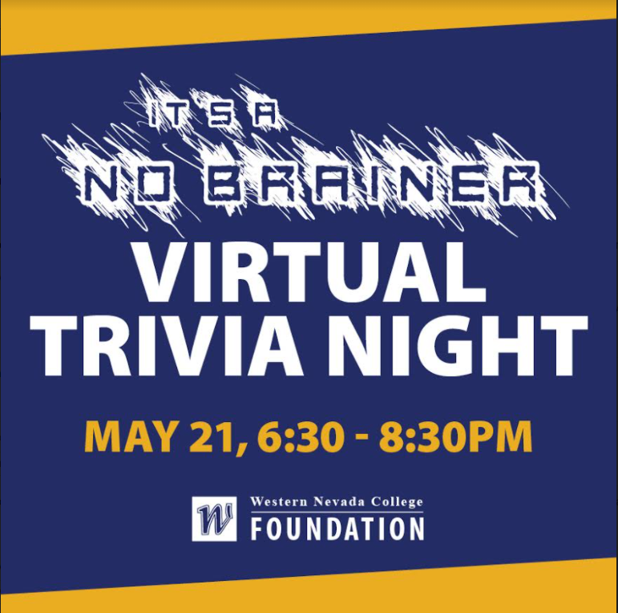
We Are Western Scholarship Celebration
The We Are Western magazine celebrates WNC donors’ generosity and congratulates WNC student scholarship recipients.
The publication was distributed to students and donors via the mail and at the WNC’s drive-through graduation. The magazine served as a safe way to recognize these accomplishments in lieu of the in-person event, We Are Western is typically held in March of each year.
WNC Foundation’s annual scholarship celebration event was canceled due to event restrictions. However, the event’s accompanying scholarship magazine, We Are Western, was published recognizing scholarship donors and celebrating over 400 students who received scholarship support through the Foundation. Additionally, WNC celebrated 50 years serving the community with 16 businesses sponsoring the publication and raising $10,000.
It’s a No Brainer WNC’s Team Trivia Night
WNC Foundation held the It’s a No Brainer Virtual Trivia Night with over 100 community members in attendance making up 30 competitive teams. The event’s host and emcee for the evening was Vice Chancellor Nate Mackinnon. The event raised over $3,000 for WNC’s emergency student fund.

Slide 10
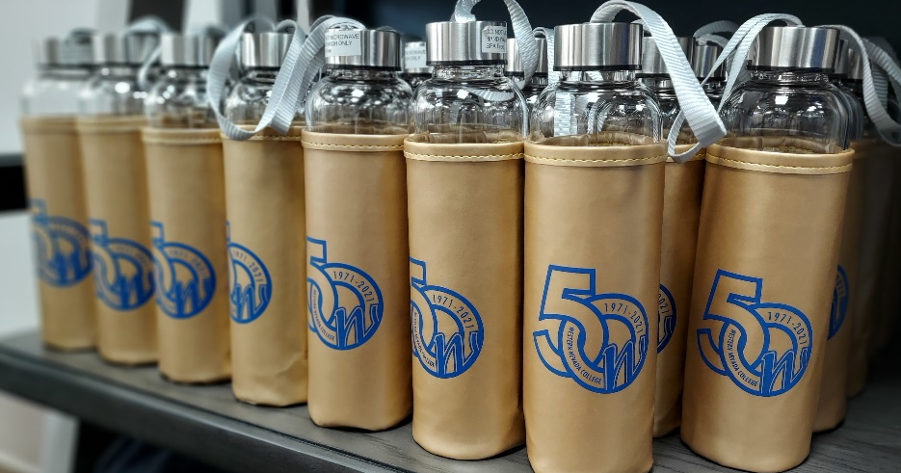

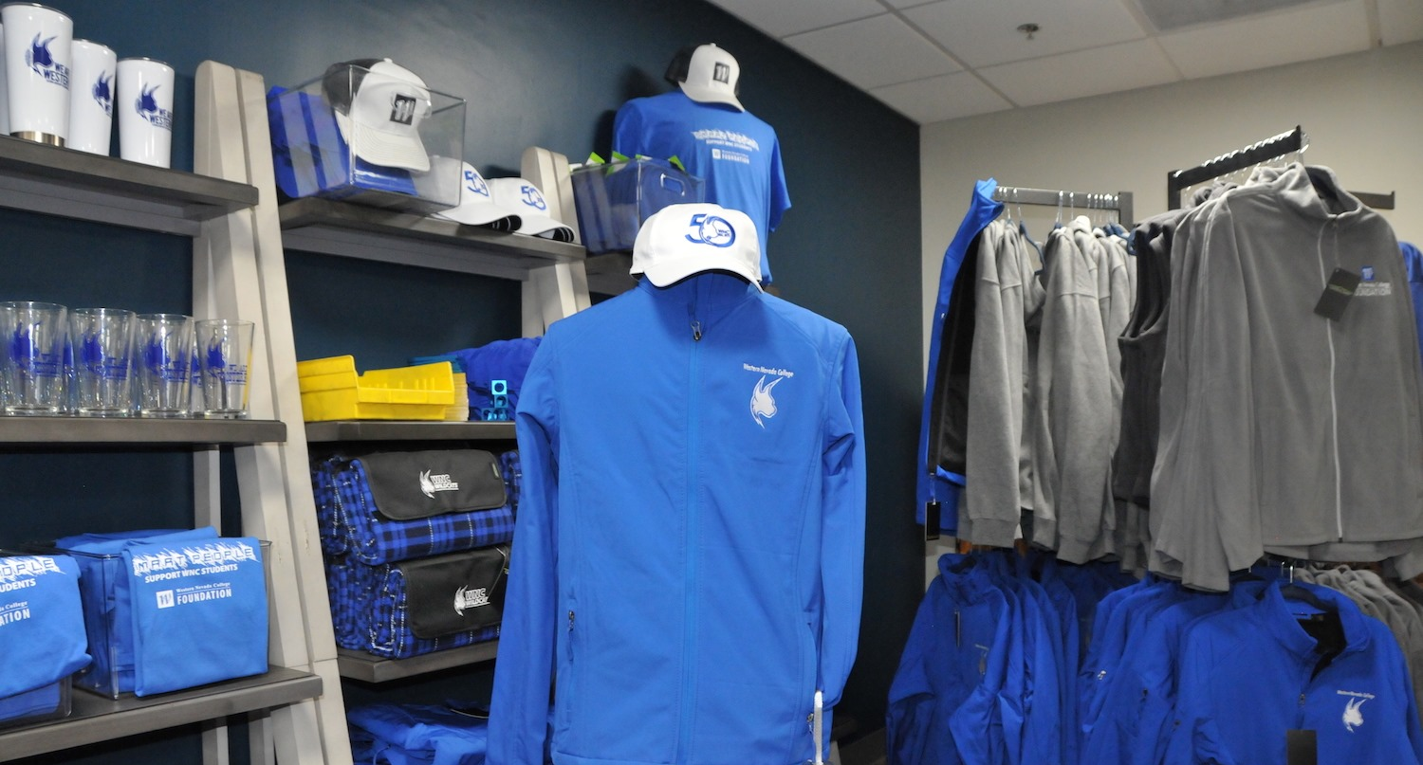
WNC Note Cards and Foundation Merchandise Store
WNC Foundation created a Foundation merchandise store in the Bristlecone Building to create an additional source of unrestricted revenue. Foundation supporters can shop for jackets, vests, beanies, T-shirts, hoodies, note cards created from student artwork, pilsner glasses, coffee cups, tumbler, hats (including a 50th anniversary hat), a trivet created by the Machine Tool Technology program and more.

Slide 11
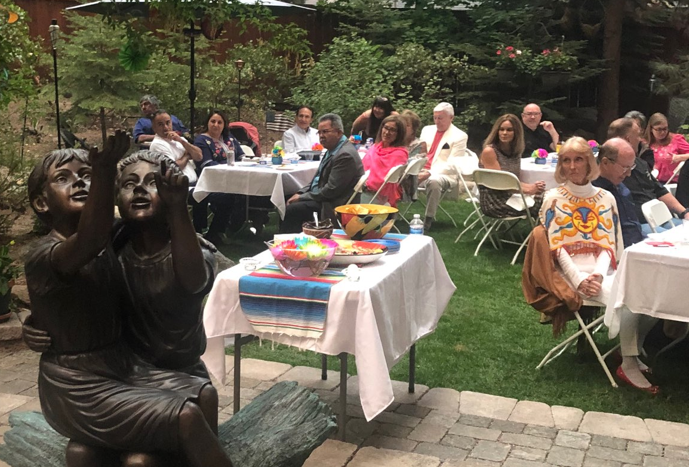
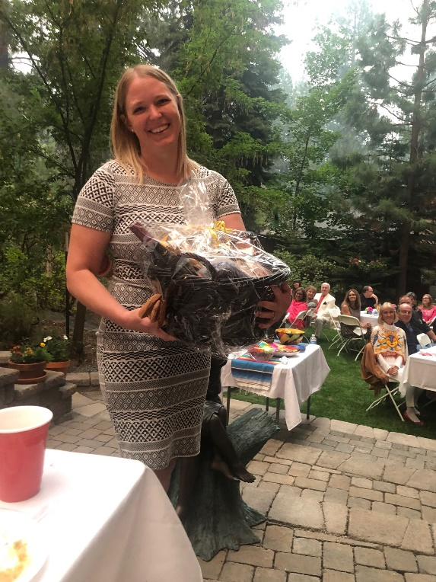
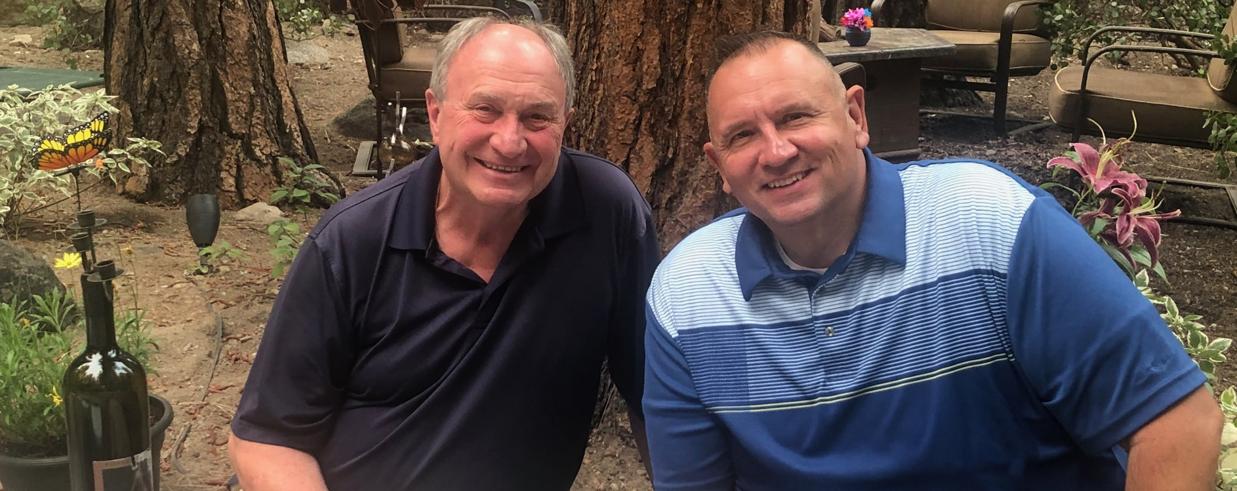
Cheers to 50 Years
Carol and George Del Carlo supported Western Nevada College with a 50th Anniversary celebration "Cheers to 50 years" at their personal residence in August. In addition to hosting the event, the Del Carlos generously donated $50,000 to start a scholarship endowment fund supporting WNC rural students residing in Nevada with financial need. The Del Carlos' generosity inspired multiple donations throughout the community and funds were raised at the event through a small, live auction.

Slide 12

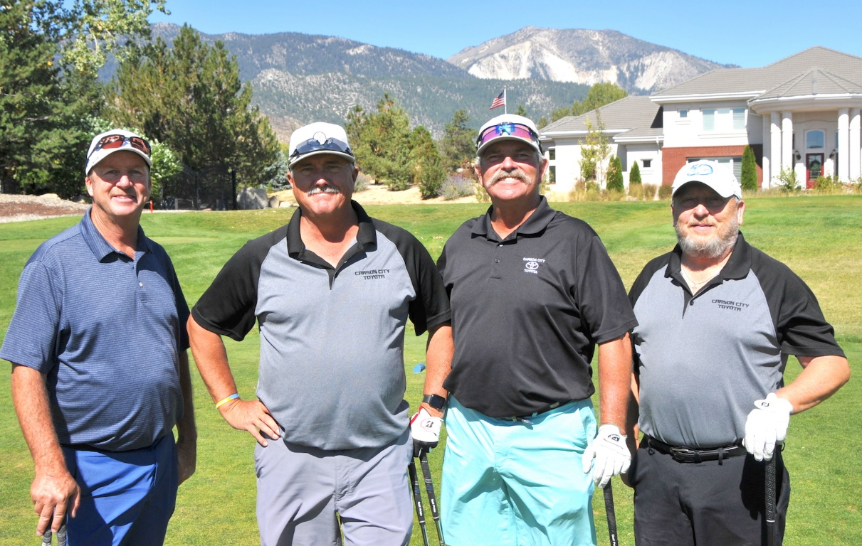

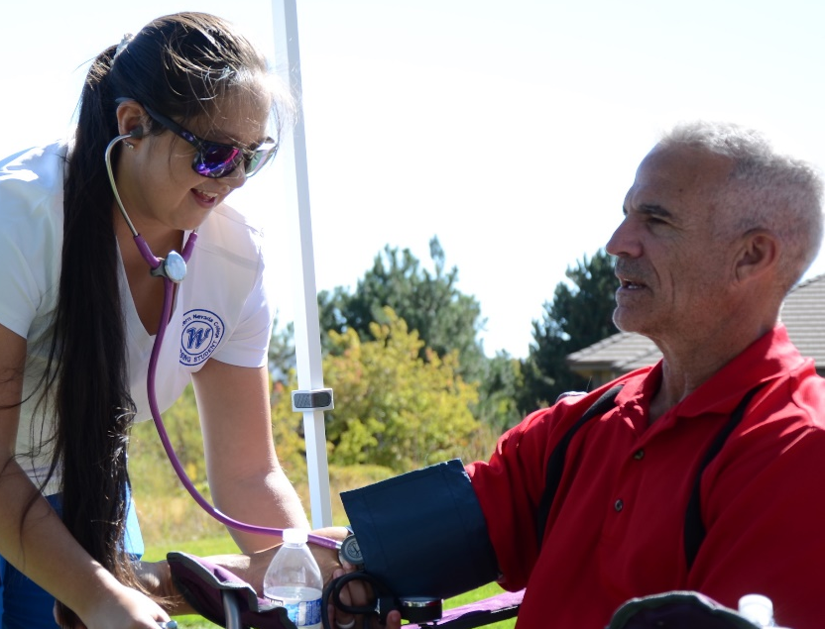
Golf For Education
FY21 and FY22 Golf for Education events were held at Toiyabe Golf Club in Washoe Valley. The presenting sponsor was Southwest Gas. Nursing students were on hand to educate and fundraise for their program. The event generated record sponsorships in FY21 with gross proceeds increasing from $25,000 in FY19 to close to $42,000 in FY21 and FY22. Mark your calendars, the 23rd Annual Golf for Education Event will be held on September 30th, 2022.

Slide 13
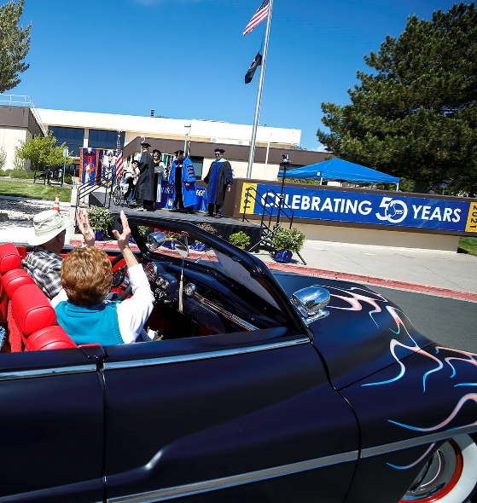
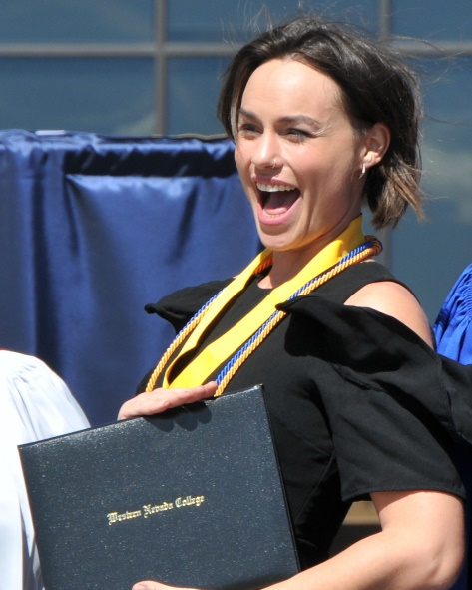
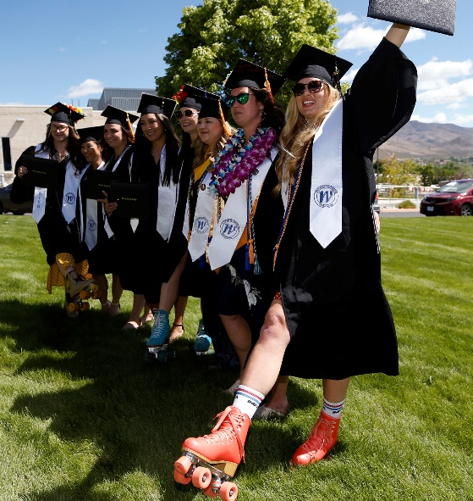
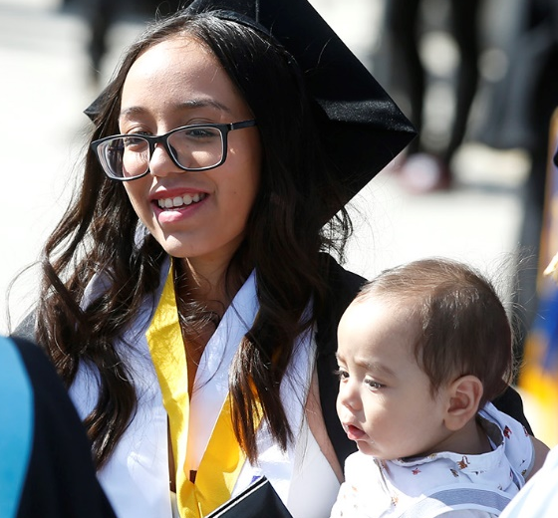
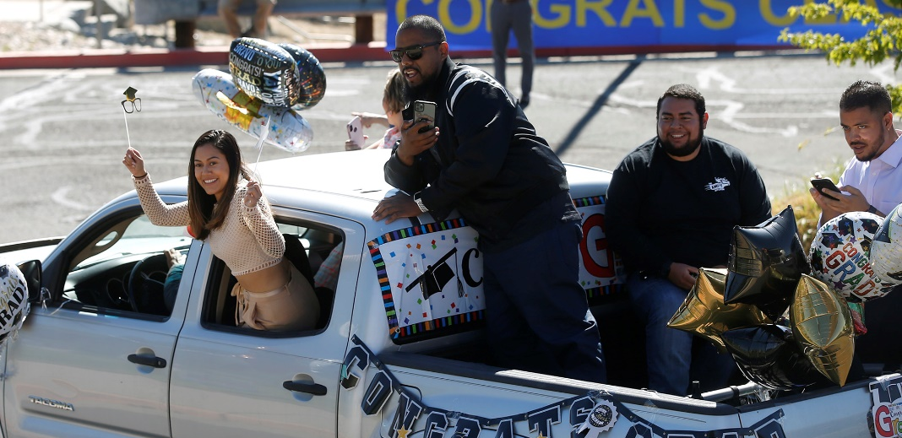
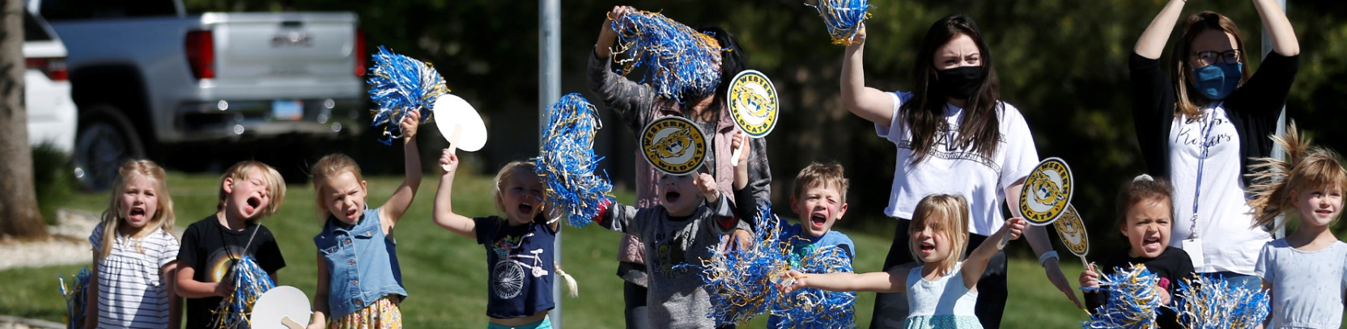
Drive Through Graduation
In 2021, WNC held its second outdoor drive-through Graduation creating a unique way to celebrate WNC graduates despite event restrictions brought by the pandemic. The event was lively, inspiring, and heart-warming. Photos taken of graduates were sponsored by WNC Foundation board member, Ronele Dotson’s company RAD strategies and a portion of the proceeds were donated to the student emergency fund within the WNC Foundation. WNC awarded 669 degrees and certificates to 641 students, 140 of these students were high school students earning their associates degrees before receiving their high school diplomas.

Slide 14

FY21 WNC Foundation Top 10 Payees
Payee | Purpose | Total
Pangborn & Co., LTD | External Financial Review/ Audit | $12,750.00
4 Imprint | Golf Tournament Items | $5,329.22
Philadelphia Insurance Companies | Annual Insurance Policy | $2,259.00
SofterWare, Inc. | Annual CRM Subscription | $1,789.20
Council for Advancement and Support of Education | Annual Membership Fees | $1,560.00
Costco | Event Fundraising Items | $1,442.86
Eleven Fifty Seven | Annual Subscription | $1,200.00
Simple Flare | Event Catering | $1,067.00
Intuit | QuickBooks Annual Fee | $1,096.29
Jeff’s Digitex Printing | Foundation Note Card Printing | $960.00
Below: Campagni Auto Group General Manager, Jeff Campagni offers a generous donation to the Western Nevada College scholarship program. Campagni Automotive Group has supported WNC students, events and programs since 2016. Most recently, the Campagni Auto Group has begun supporting WNC’s Prison Education Program.

Slide 15
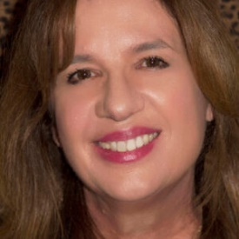
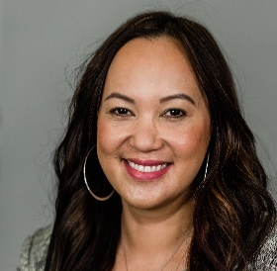
WNC Foundation Board of Trustees
The WNC Foundation Board of Trustees guides the WNC Foundation in donor development, financial stability and growth. The foundation strives to align support and fundraising efforts with the WNC Strategic Plan.
The Board of Trustees for the WNC Foundation unanimously approved the appointments of the following community members to serve on the WNC Foundation Board from July 1, 2021 through June 30, 2023. The WNC Foundation Board respectfully requests that the Board of Regents approve these appointments:
WNC Foundation Board of Trustee Officers for FY22 – 23:
Chair: Sean Davison Secretary and Treasurer: Scott Fields
Vice Chair: Michelle Ketten Co-Vice Chair: Tina Holland
Renewing Trustees for FY22-23:
New Trustee Nominations for FY22 -23:
WNC Foundation Staff
Jeff Brigger Barbara D’Anneo Ronele Dotson | Kathy Halbardier Miranda Hoover Amanda Jacobsen Lane Mills | Darcy Houghton Rick Kohler Sena Loyd Rochelle Tisdale Devin Sizemore | Stacey Woodbury Rochelle Tisdale Julie Wood
Maria Denzler, Novelist and Fine Art Photographer
Christie Asis, United Federal Credit Union Regional Market Development Manager
Niki Gladys, Director of Institutional Development
Carol McIntosh, Assistant Director
Rachael Schneider, Rural Development and Outreach Coordinator

Slide 16

Thank you!
The WNC Foundation sincerely appreciates the continued support of the Nevada System of Higher Education and the Board of Regents. We are proud of the work our board of trustees has accomplished over the past year on behalf of Western Nevada College. The WNC Foundation Board of Trustees prides itself in being a working board that directly contributes to student success in alignment with the strategic plan for the college by connecting the college to our community.
Below: Guests enjoy the 2019 Reach for the Stars fundraiser. WNC Foundation Aspires to hold the 5th Annual event in 2022.

