Slide 1
Fernley Industrial Developments
Andrew Haskin
Deputy Director
10/28/2020

Slide 2
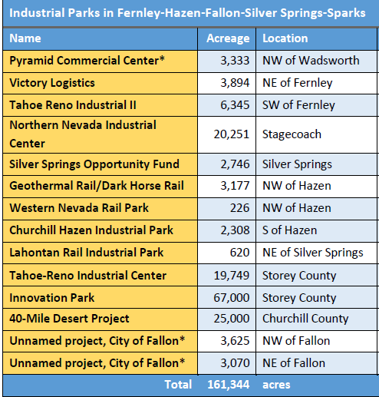
List of Proposed and Active Projects
2
1/14/2021

Slide 3
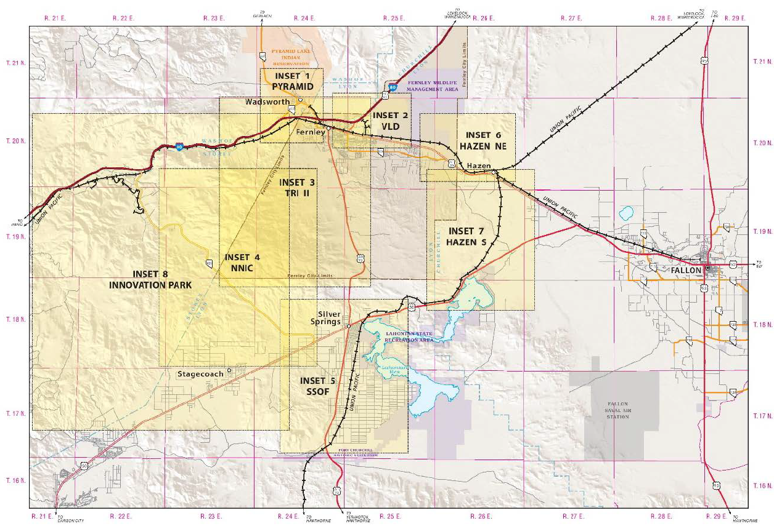
But Wait …There’s More …
3
1/14/2021

Slide 4
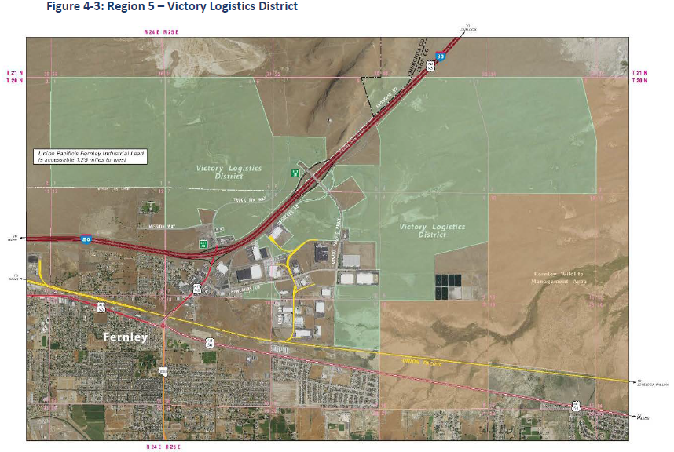
Victory Logistics District
4
1/14/2021

Slide 5
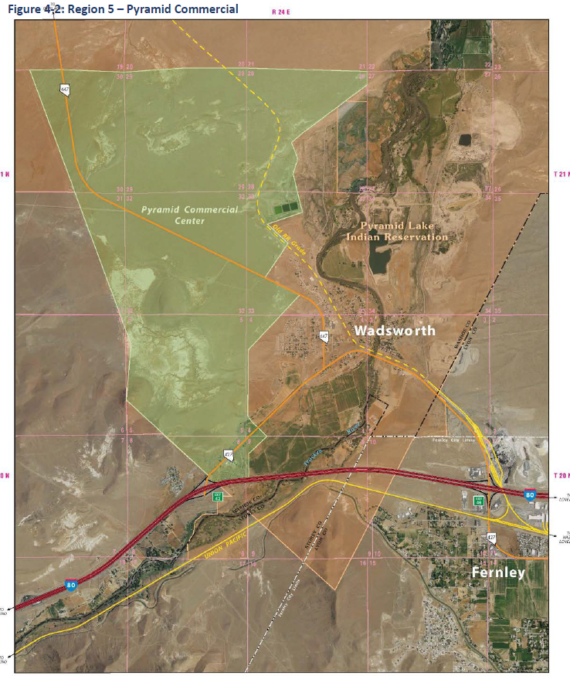
Pyramid Commercial Center
5
1/14/2021

Slide 6
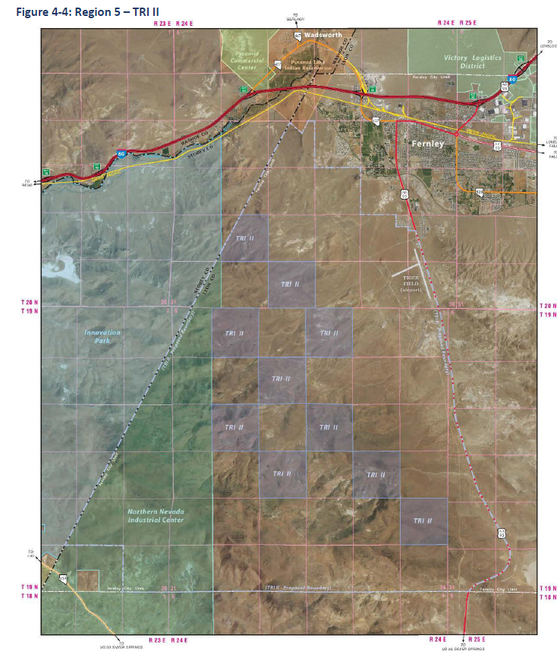
TRI II
6
1/14/2021

Slide 7
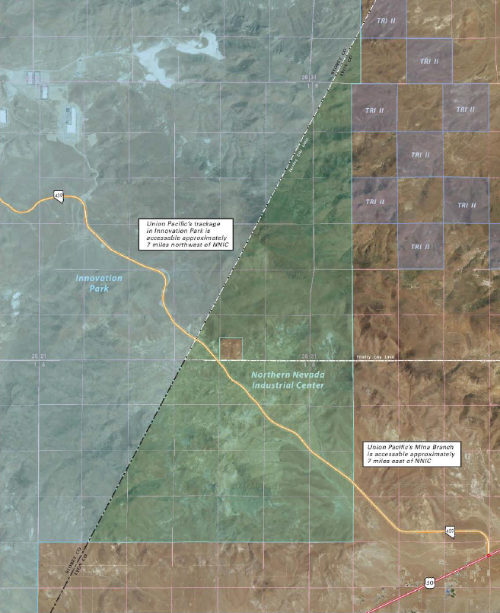
Northern Nevada Industrial Center
7
1/14/2021

Slide 8
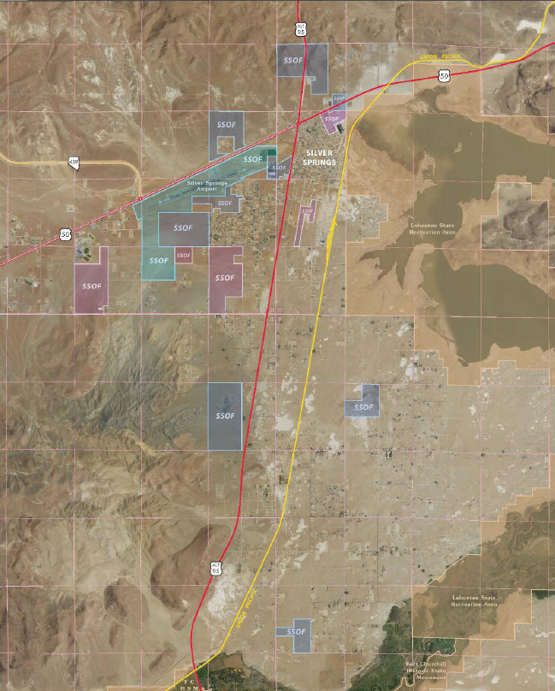
Silver Springs Opportunity Fund
8
1/14/2021

Slide 9
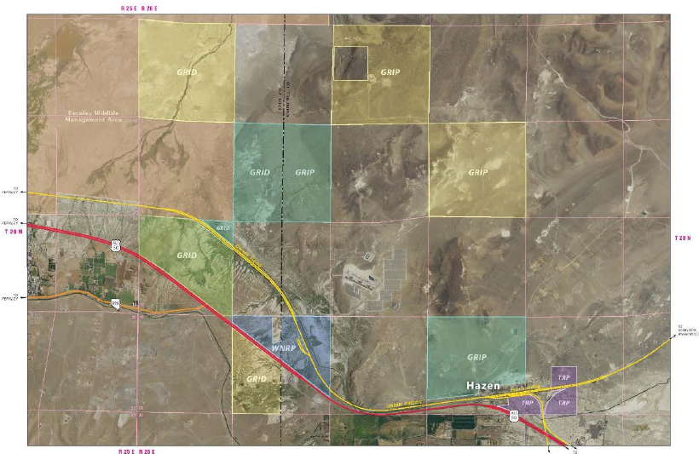
Hazen Projects
9
1/14/2021

Slide 10
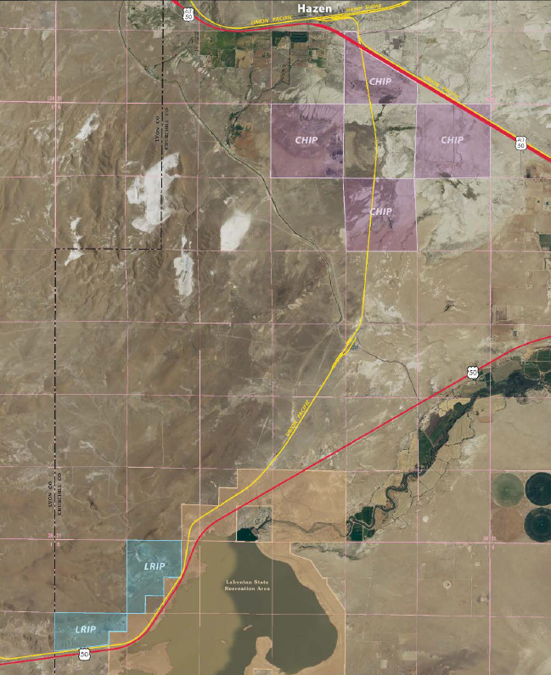
Hazen Projects (Continued)
10
1/14/2021

Slide 11
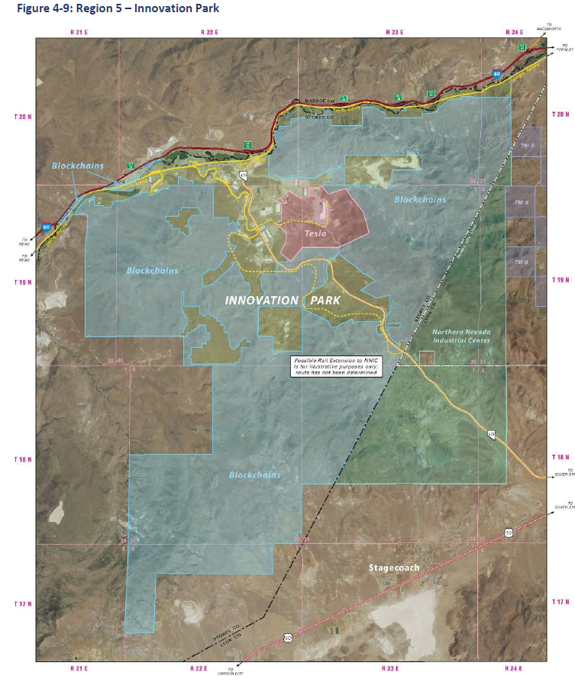
Tahoe Reno Industrial Center
11
1/14/2021

Slide 12
Questions?
Andrew Haskin
Deputy Director
10/28/2020

