Slide 1
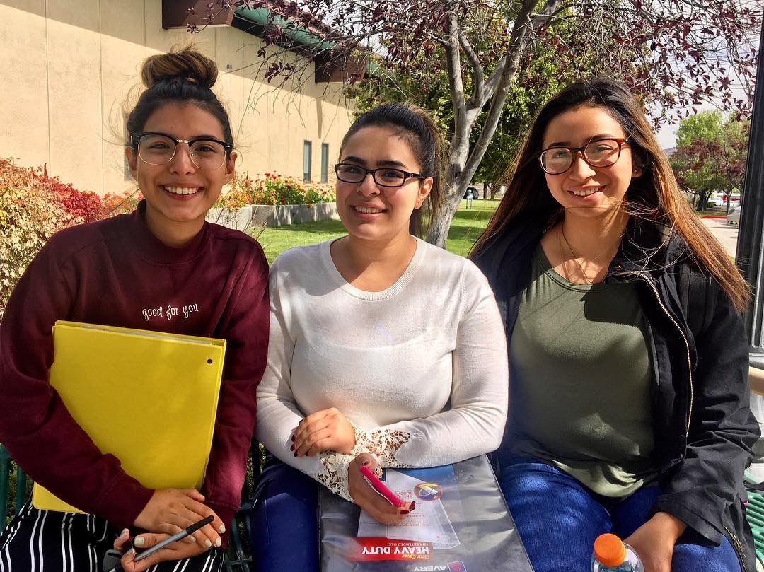
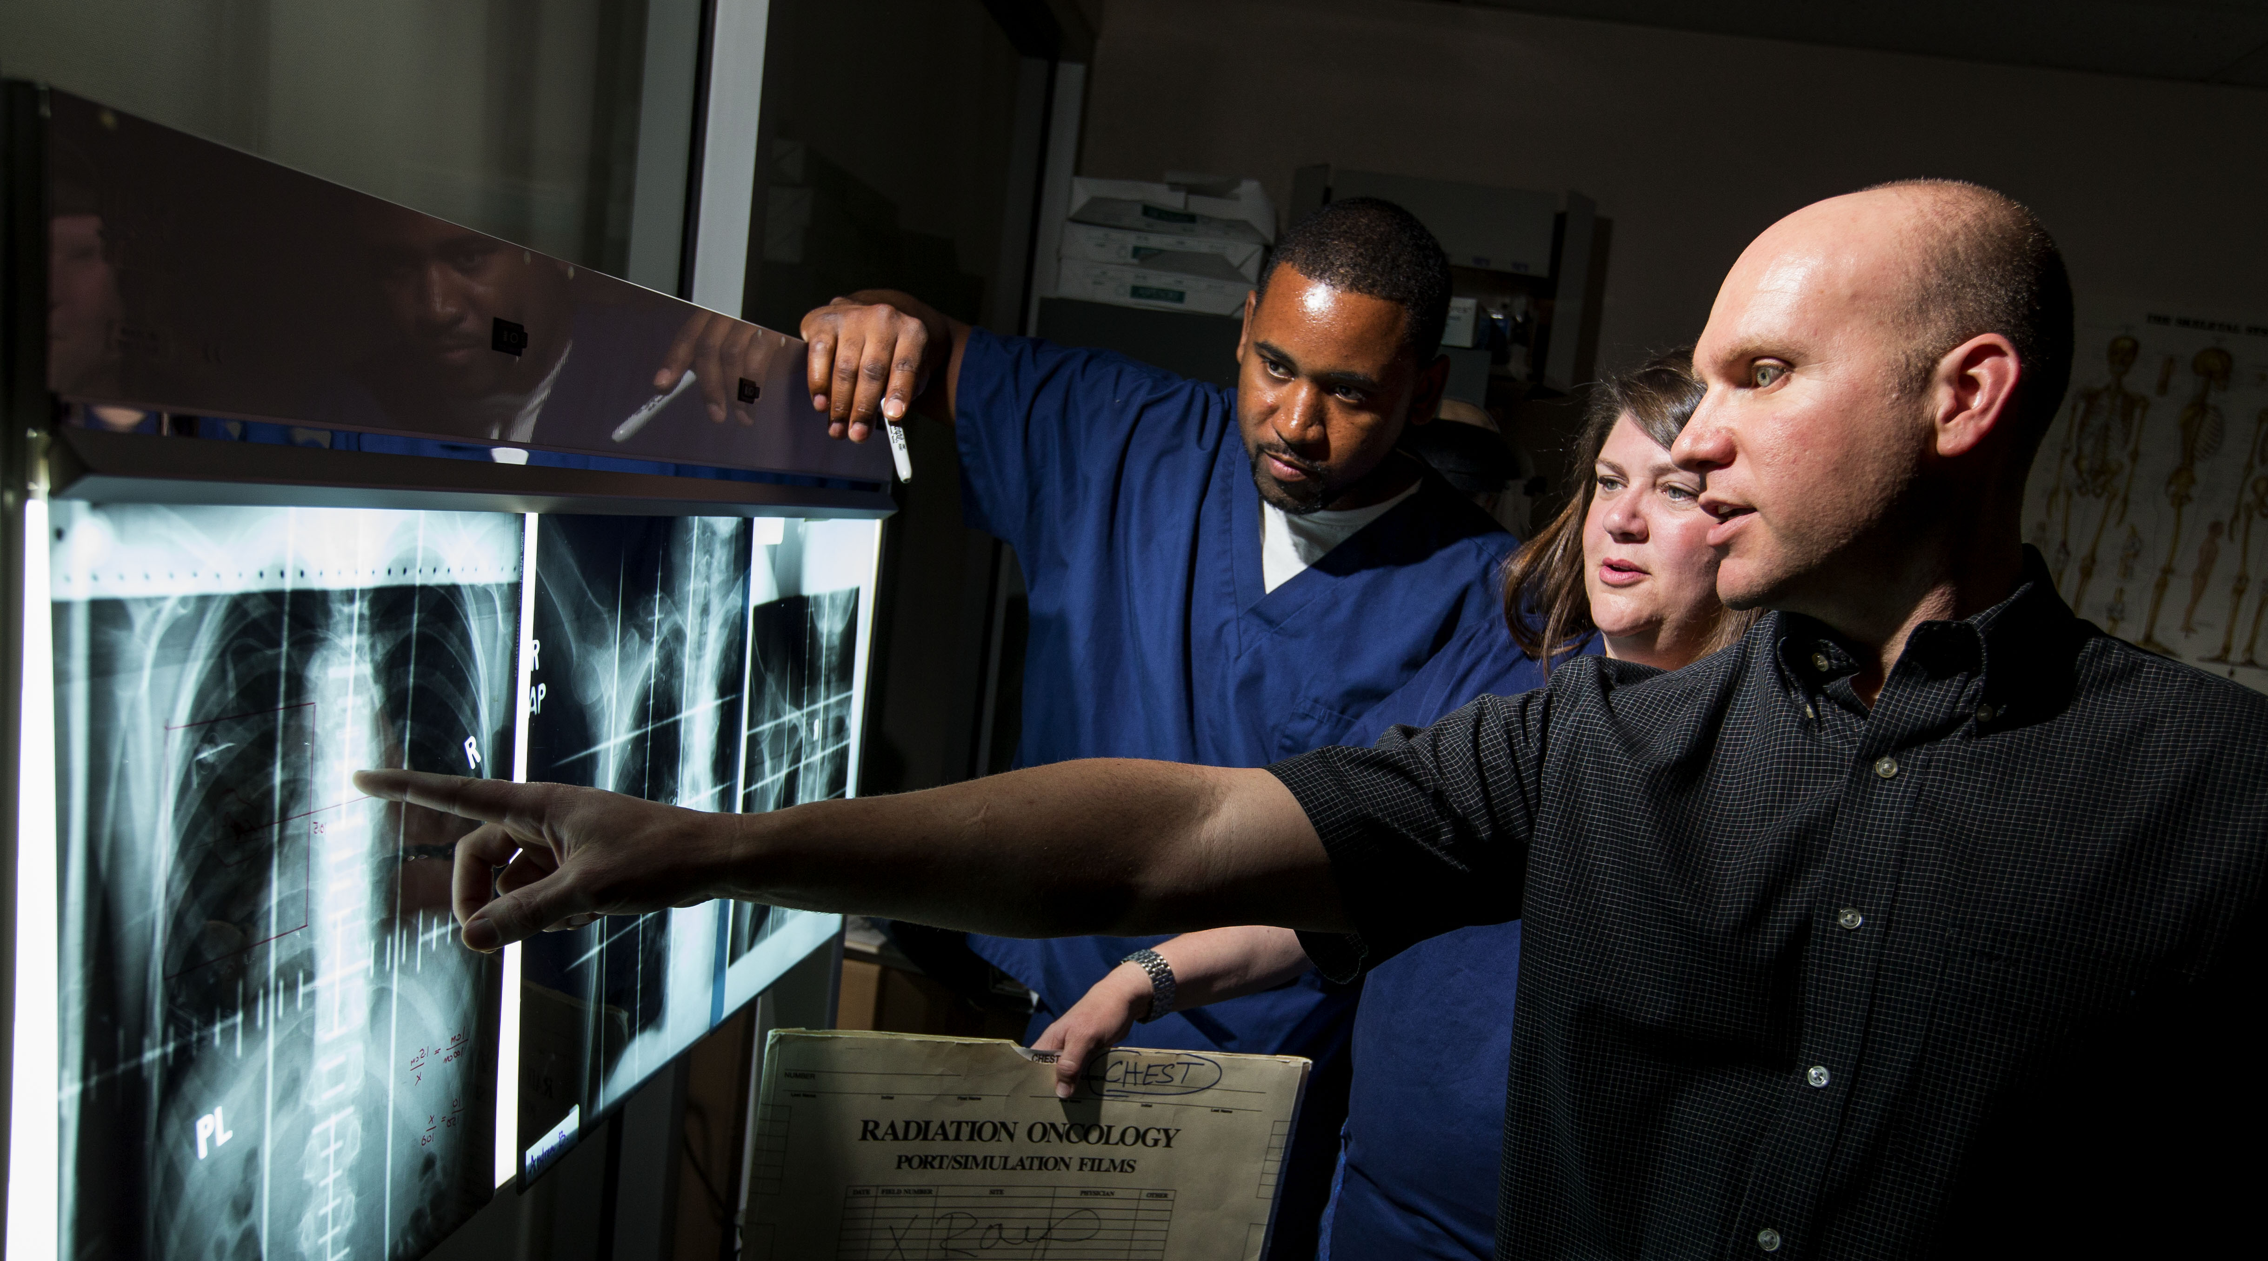
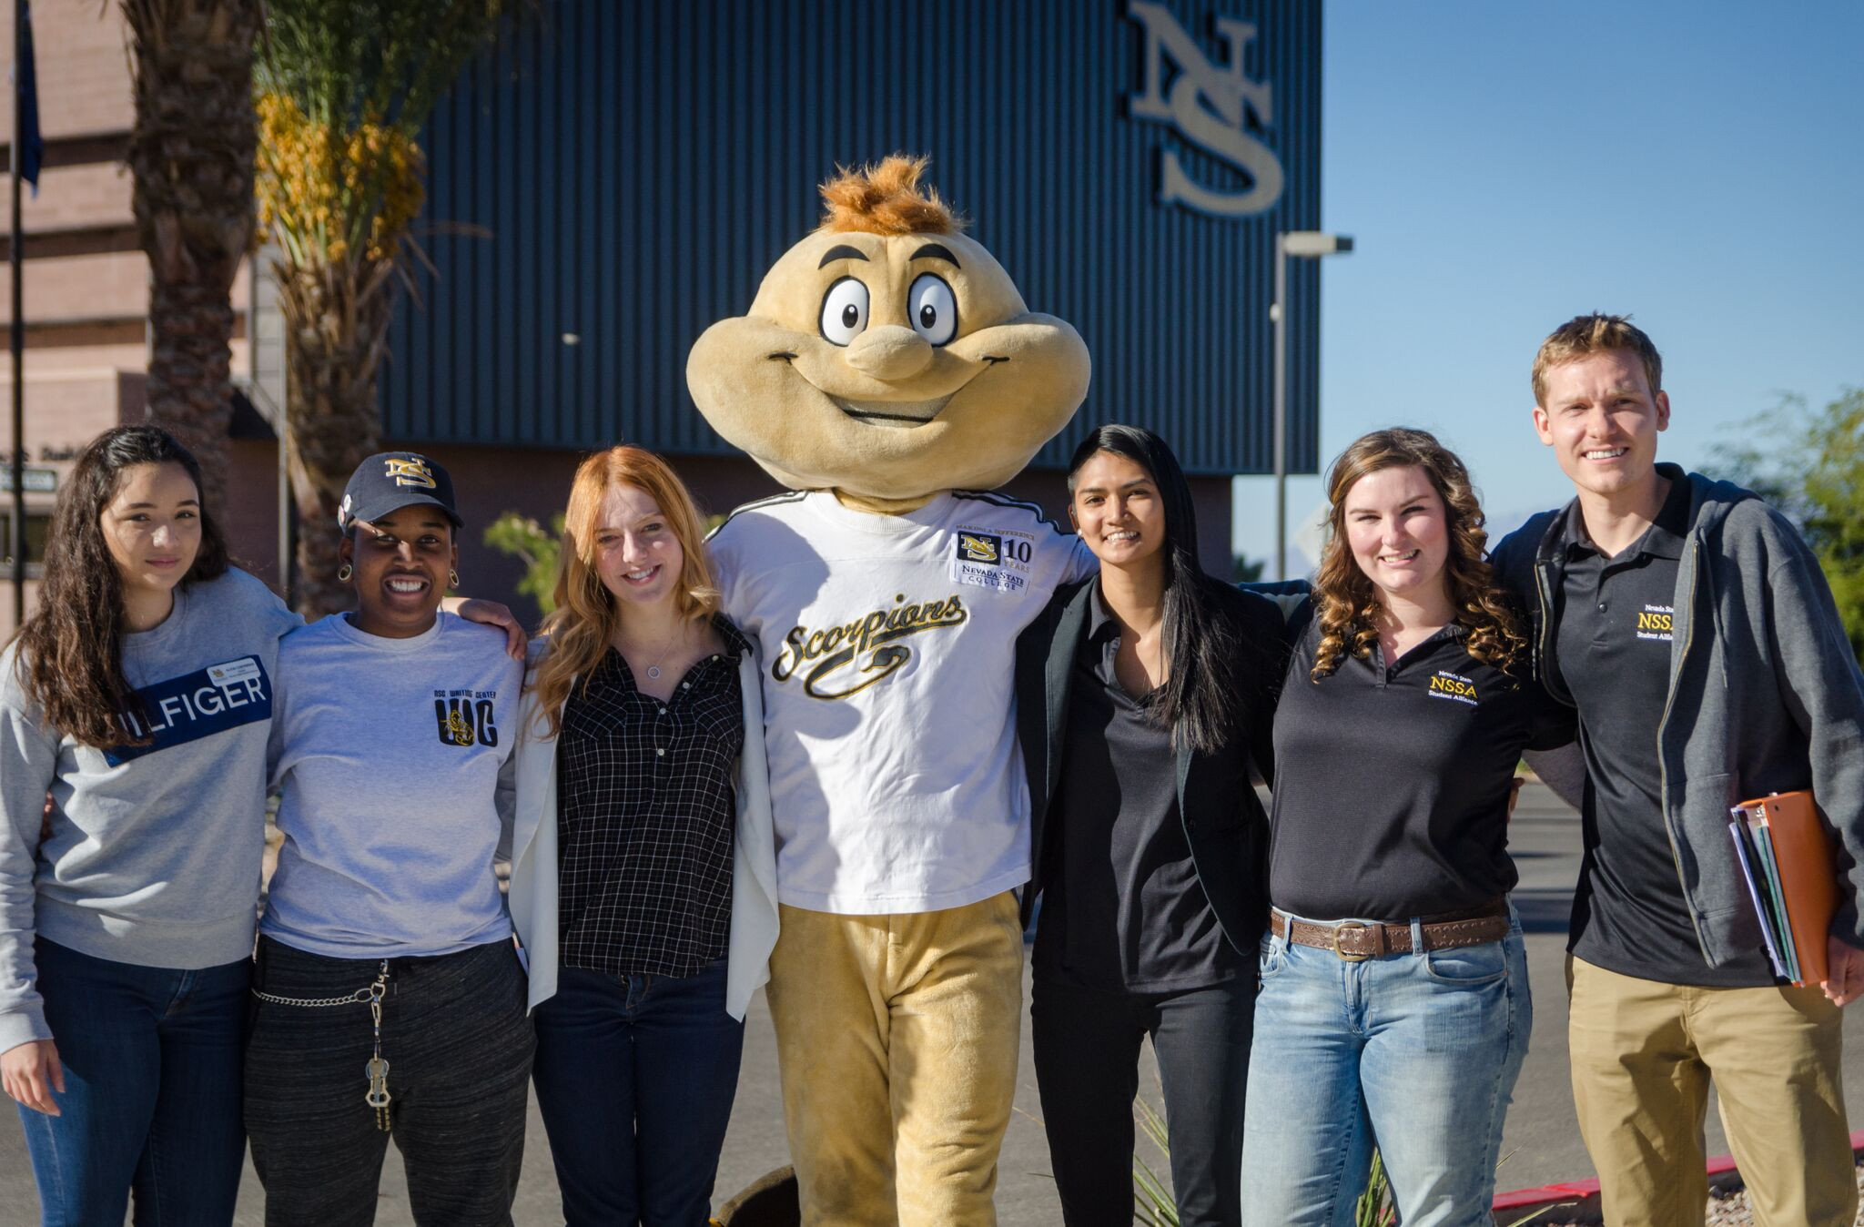
2019 Legislative Overview
J. Kyle Dalpe, Ph.D.
Interim Executive Director of Legislative Affairs, NSHE
March 27, 2019

Slide 2
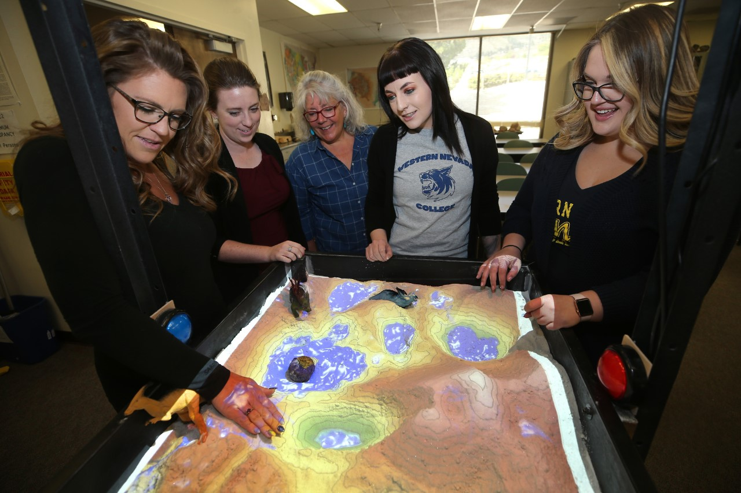
2019 Session
70 days left (out of 120)
Assembly - 29D 13R 23W 19M
Senate - 13D 8R
Tracking 180+ bills

Slide 3
NSHE Institutions
College of Southern Nevada
Great Basin College
Truckee Meadows Community College
Western Nevada College
Nevada State College
University of Nevada, Las Vegas
University of Nevada, Reno
Desert Research Institute

Slide 4
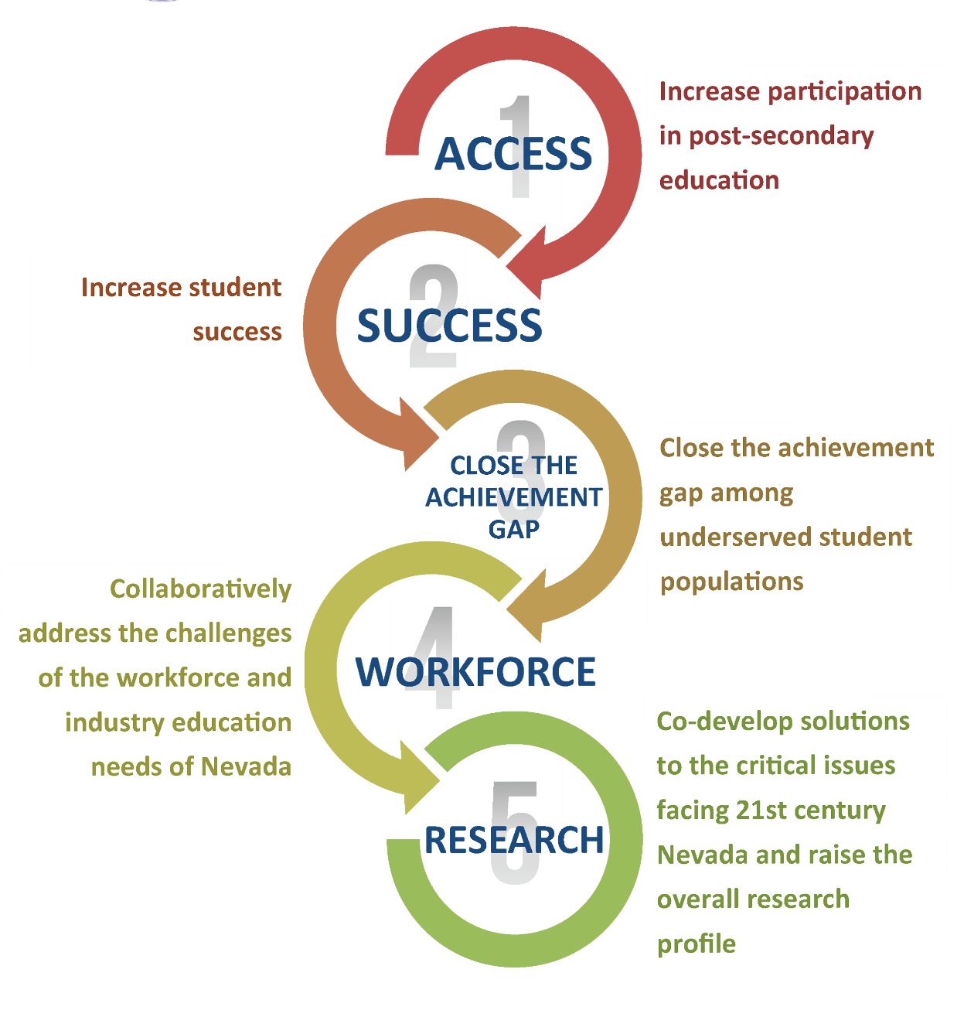
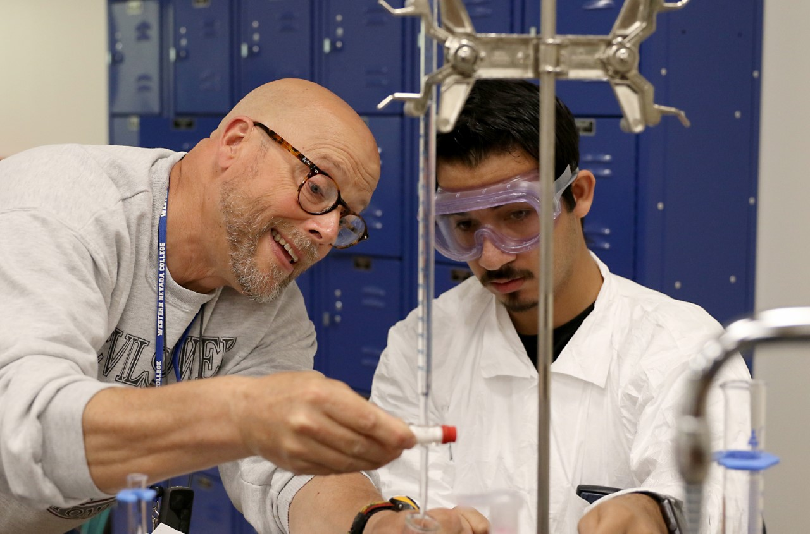

Slide 5
Fall 2017 Enrollment: 107,864
Ethnicity
American Indian/Alaskan Native: 0.7%
Asian: 9.8%
Black, non-Hispanic: 6.8%
Hispanic: 26.9%
Native Hawaiian or
Other Pacific Islander: 0.9%
White: 42.0%
Two or More Races: 6.5%
Unknown: 6.4%
Gender
Female: 57.0%
Male: 43.0%
Enrollment Load
Full-time: 50.6%
Part-time: 49.4%
Notes:
Enrollment: coming from Crystal

Slide 6
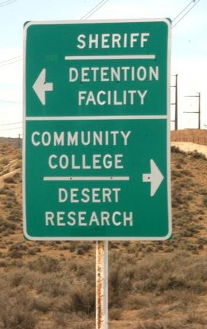

Slide 7
Funding Formula Overview
General Fund distribution for instruction is formula driven
Measured by completed Weighted Student Credit Hours (WSCH)
Not tied to enrollments or headcount; tied to completions
Reimbursement rate is same for all 7 instructional institutions ($156.01)
Based on FY18 actual WSCH; not future projections
Periodic adjustments are recommended by NSHE
2017 Session increased funding for CTE courses at community colleges (approved)
2019 Session being asked to include funding for Summer STEM/CTE (enhancement request)

Slide 8
Funding Requests Overview
Formula Caseload Growth ($21M each FY)
Formula adjustments
Capacity Building ($18.2M in FY20; $22.45M in FY21)
Institution specific projects
Continuation of FY 19 – 5 year plans
Summer School Funding ($15.4M in FY21)
Limited to specific STEM/CTE CIP codes
Increases options for degree completion
New Performance Pool ($7.5M in FY21)
Support 5 NSHE Goals
UNLV School of Medicine Ramp-Up ($4.2 M in FY20; $10.1 M in FY21)
Additional Staff & Operating for 60 students/year growth
Achieve goal of 240 student enrollments by FY 21

Slide 9
Formula Caseload Growth (base)
Caseload Growth | FY 20 | FY 21
UNLV | $10.78m | $10.78m
UNR | $6.46m | $6.46m
CSN | $1.32m | $1.32m
GBC | ($1.18m) | ($1.18m)
TMCC | ($0.28m) | ($0.28m)
WNC | $0.38m | $0.38m
NSC | $3.84m | $3.84m
Total | $21.13m | $21.13m

Slide 10
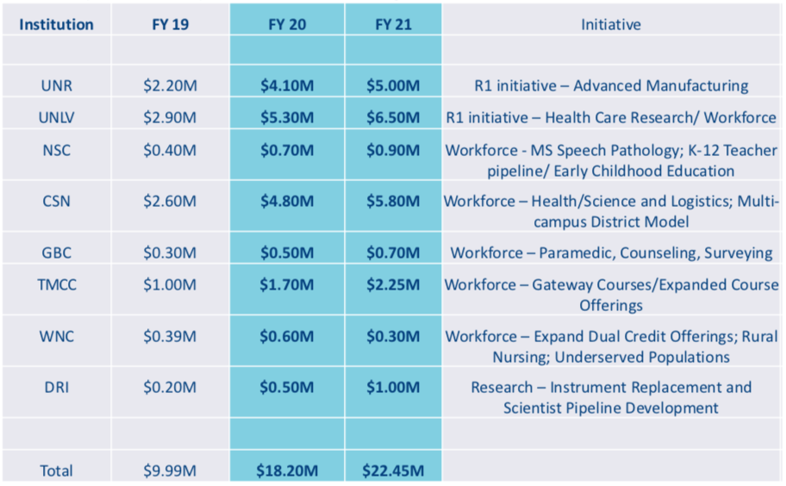
Capacity Building

Slide 11
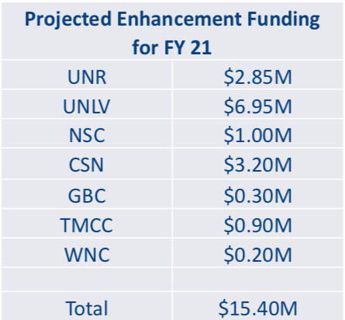
Summer School (not funded)

Slide 12
Performance Pool (not funded)
Projected Enhancement Funding
$7.5 M in FY 21
Distribution Methodology
Tied to Regents’ Strategic Goals
Earned if stretch goals met:
Persistence/Completion
Use of funds earned:
Discretion of each institution
Could be used to address salary issues

Slide 13
Faculty/Staff Compensation (not funded)
Summary of Salary Study Findings
~$90M plus issue to address compression
AB 202 Recommendations
Issue has been a long time in the making and won’t be solved overnight
System-wide plan for addressing the issue
Target next 3 sessions, 1/3 of amount each session
2019-2021 Goal: $30M per FY
($20 M State; $10 M Institutional Funds)
Notes:
Supplemental Request

Slide 14
Non-Formula Budget Enhancements
Institution | FY 20 | FY 21 | Total
1. Prison Education Program* | $416,742 | $459,051 | $875,793
2. UNR Cooperative Extension | $1,170,000 | $3,516,000 | $4,686,000
3. DRI NV Graduate Fellowship | $360,328 | $540,492 | $900,820
4. DRI NV Cloud Seeding | $899,659 | $899,205 | $1,798,864
5. UNR Statewide Programs | $871,332 | $2,059,672 | $2,931,004
6. UNLV School of Dental Medicine | $1,051,600 | $792,100 | $1,843,700
7. UNLV Student Athlete Financial Aid | $2,933,619 | $2,933,619 | $5,867,238
8. CSN Athletic Scholarships | $250,000 | $250,000 | $500,000
*funded for CSN, TMCC and WNC

Slide 15
Capital Improvement Projects
Board of Regents’ Prioritization
(based on SPWB construction estimates Nov 2018)
Construction:
NSC Education Building - $62 M ($56 M State; $6 M NSC)
CSN Health and Sciences Building - $77 M ($71 M State; $6 M CSN/NSC)
UNLV Engineering Academic and Research Building - $66 M ($33 M State; $33 M UNLV/Donor)
Planning:
GBC Welding Lab Expansion - $524,000 ($489,000 State; $35,000 GBC)
UNLV Science Academic-Research Building - $6.8 M ($3.8 M State; $3 M UNLV)
WNC Marlette Hall Refurbishment - $105,000 State
TMCC/DRI Science Solutions Center - $5 M State
CSN Northwest Campus - $4 M State
UNR Life Sciences Building - $6 M
($3M State, $3M UNR/Donor)
NSC Water Tank - $416,000 State

Slide 16
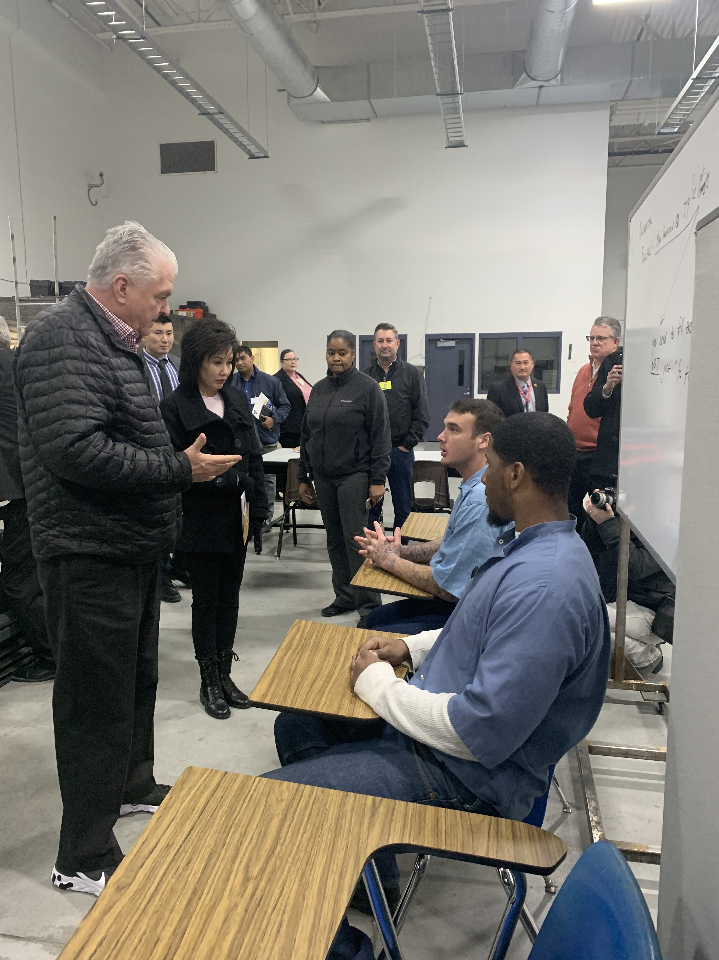
Prison Education
CSN Prison Education Pilot Program was established through Senate Bill 306 during the 2017 legislative session
New funding will support program at CSN, WNC and TMCC
$760,000 for the biennium

Slide 17
State-Supported Financial Aid Programs
Governor Guinn Millennium Scholarship ($33M)
A merit-based scholarship program intended to increase the number of Nevada students who attend and graduate from Nevada institutions of higher education
Permanent funding
Silver State Opportunity Grant Program ($10M)
The state’s first state-supported, need-based financial aid program created in the 2015 Session of the Nevada State Legislature
Changes this session (12/12/6, 12/12)
Promise Program ($4.5M) SB350, AB463
Last-dollar program created in the 2017 Session of the Nevada State Legislature
Students who wish do attend a community college to pay registration fees
Technical updates
Promise Reconnect SB255
Non-high school students who wish do attend a community college; credit restrictions
TMCC
Notes:
Source: NSHE Official Enrollment

Slide 18
Other Interests
Governance (AJR5, AB350, SB354)
WINN Funding (AB32)
Benefits/Healthcare
Salary Scale/Compression (SB214)
Collective Bargaining (AB103, SB459)
Prevailing Wage (AB136, AB190, AB196)
Rural CC Day WNC/GBC – May 3
Notes:
Source: NSHE Official Enrollment

Slide 19
J. Kyle Dalpe, Ph.D.
(775) 745-1156
kdalpe@nshe.nevada.edu

