Slide 1

Enrolling for the Emergency Medical Services (E.M.S.)and Phlebotomy (L.T.E.) Courses
This is a step by step process of everything you will need to do prior to enrolling . Please click to continue through the presentation at your leisure. At the bottom left corner are the navigation keys to go back to a previous screen if needed. This will guide you through the online process with screenshots.

Slide 2
Apply & Register as a student with WNC
Apply for admission at www.wnc.edu. Click Apply & Register. Click Apply Now. You will receive your NSHE Student ID Number and password via e-mail in 3-5 business days. Then you will need to follow the e-mail instructions to activate your myWNC account. You will need this information in order to enroll.

Slide 3
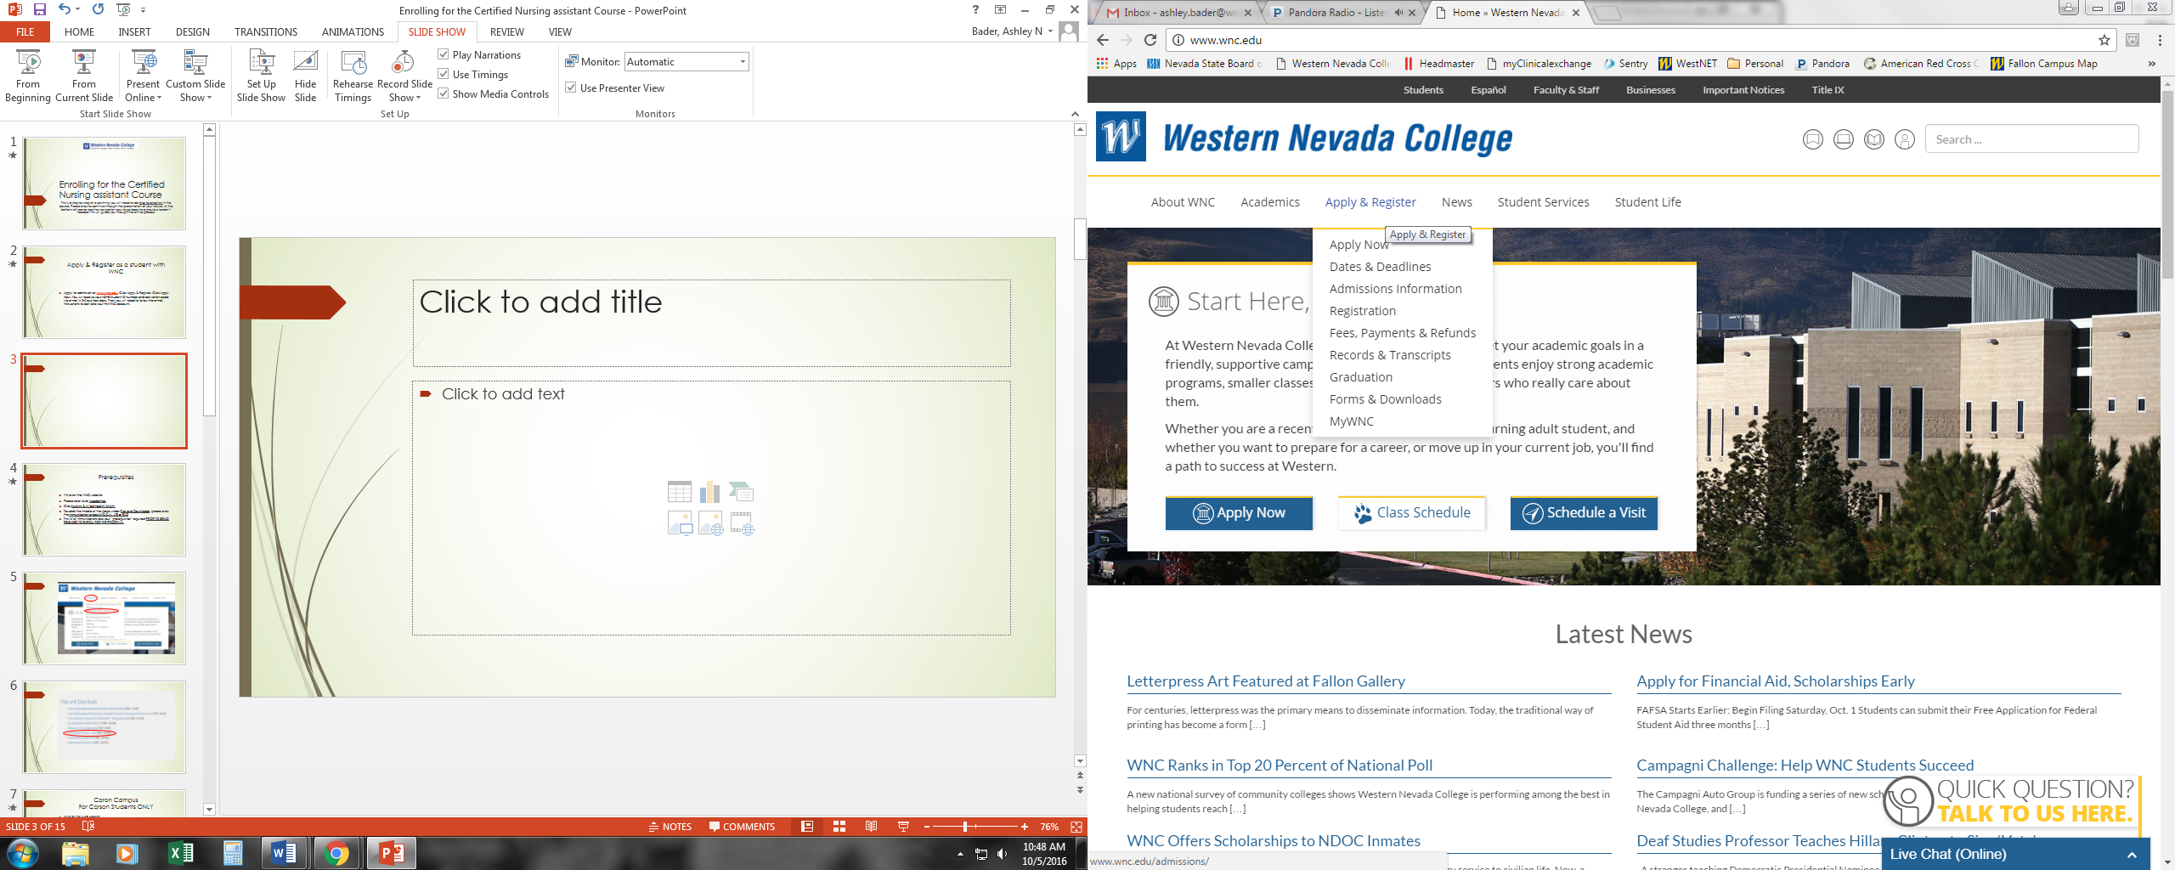

Slide 4
Essential Requirements (Prerequisites)
While on the WNC website:
Please scroll over to Academics
Click Nursing & Allied Health (NALH)
Towards the middle of the page under Flies and Downloads, please click on the Immunization checklist- LTE or EMS respectively
This list of immunizations are your “prerequisites” required PRIOR TO BEING RELEASED TO ENROLL FOR THE PROGRAM.

Slide 5
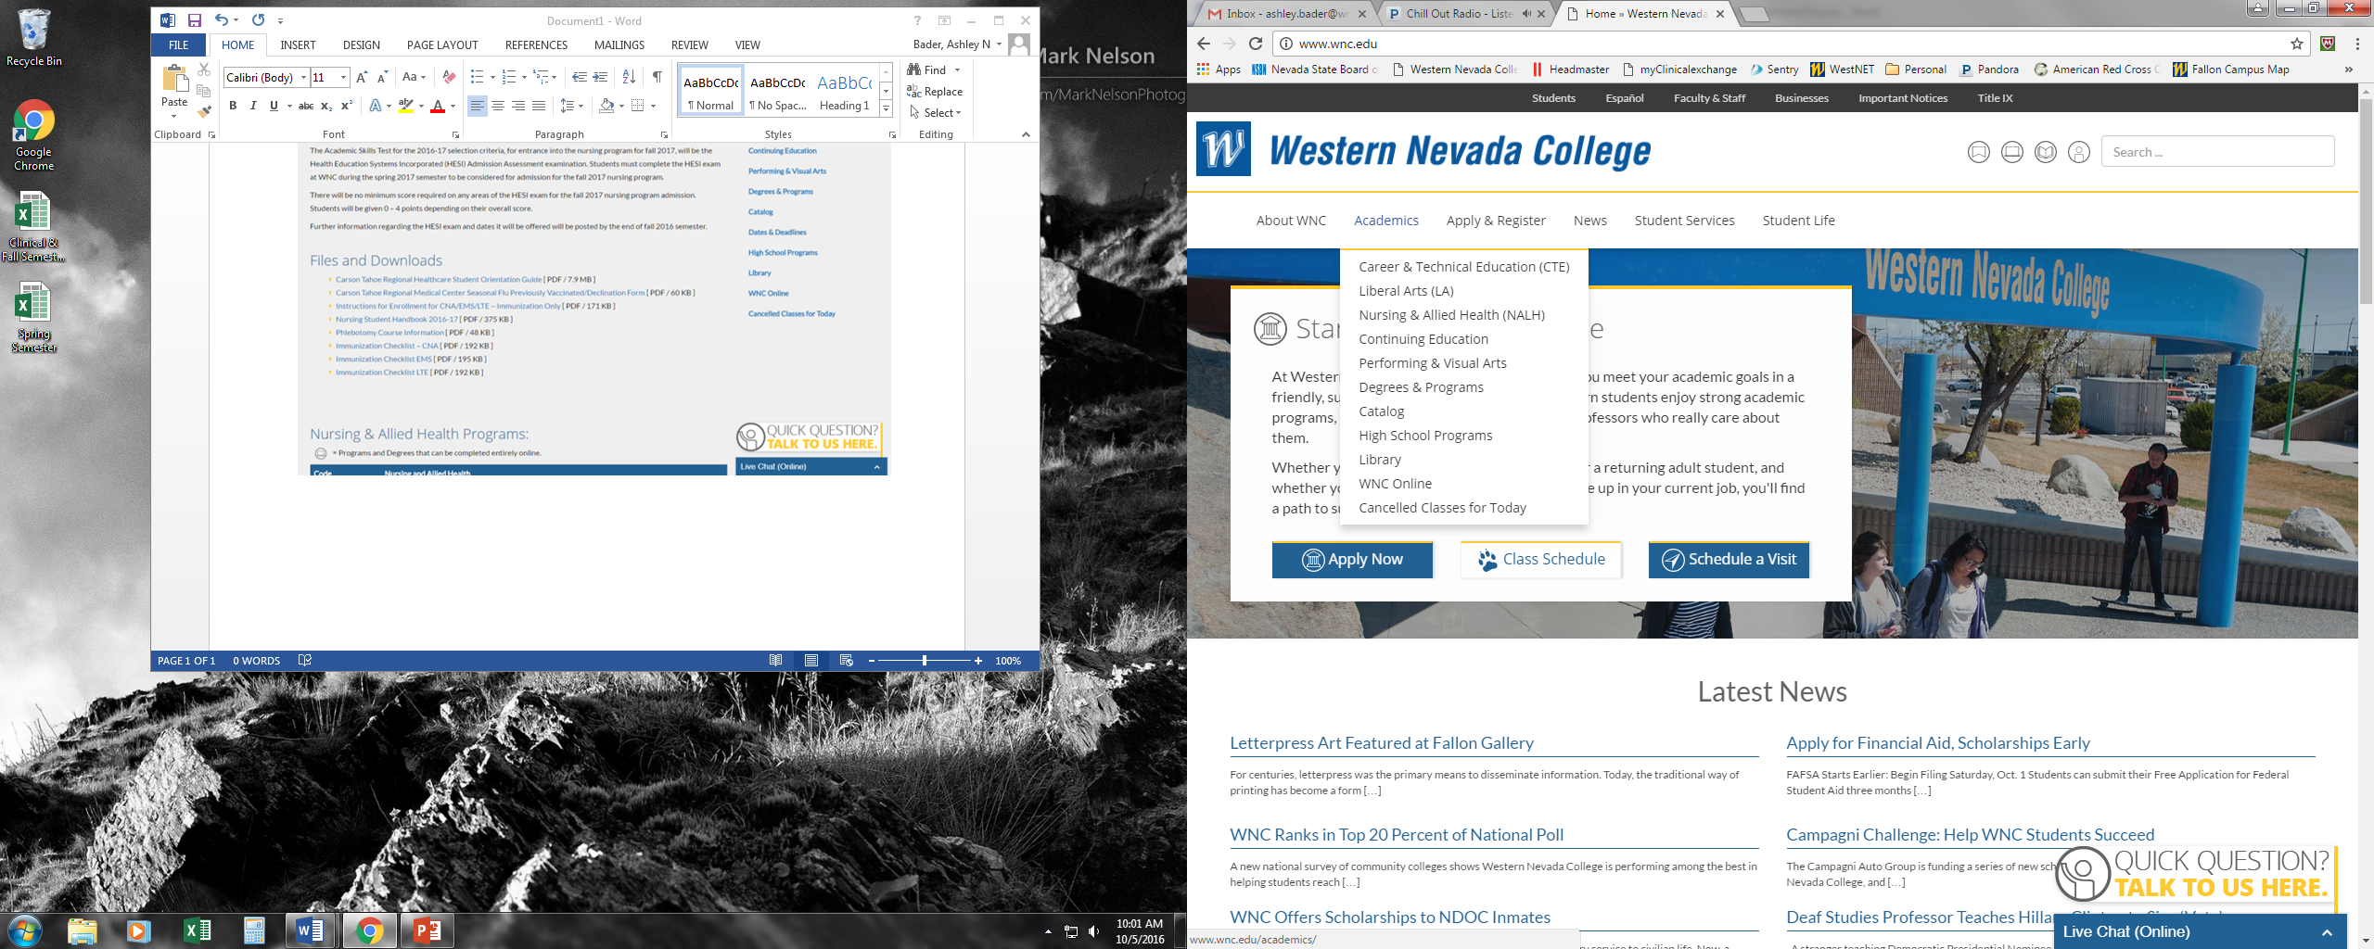

Slide 6
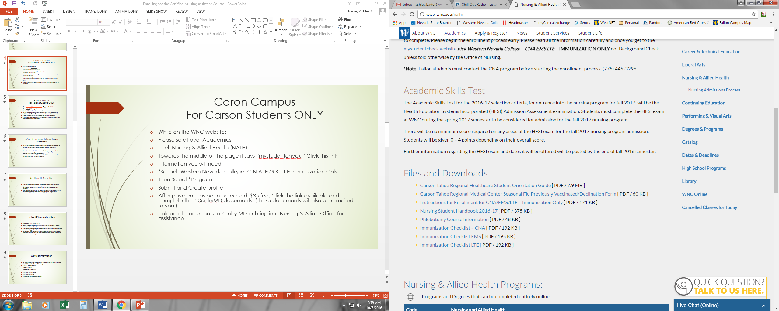

Slide 7
Carson Campus
While on the WNC website:
Please scroll over to Academics
Click Nursing & Allied Health (NALH)
You will need to open an account at SentryMD via student check.
Towards the middle of the page it says “mystudentcheck,” Click this link.
Information you will need:
*School- Western Nevada College- C.N.A. E.M.S L.T.E - Immunization Only
Then Select *Program – E.M.S or L.T.E.
Submit and Create profile
After payment has been processed ($35 fee) Click the link available and complete the 4 SentryMD documents. (These documents will also be e-mailed to you.)
Upload all documents to Sentry MD via Fax at 1(817)-251-9593 or 1(214) 619-1830 Also via e-mail at wnc@sentrymd.com or bring into Nursing & Allied Office for assistance.

Slide 9
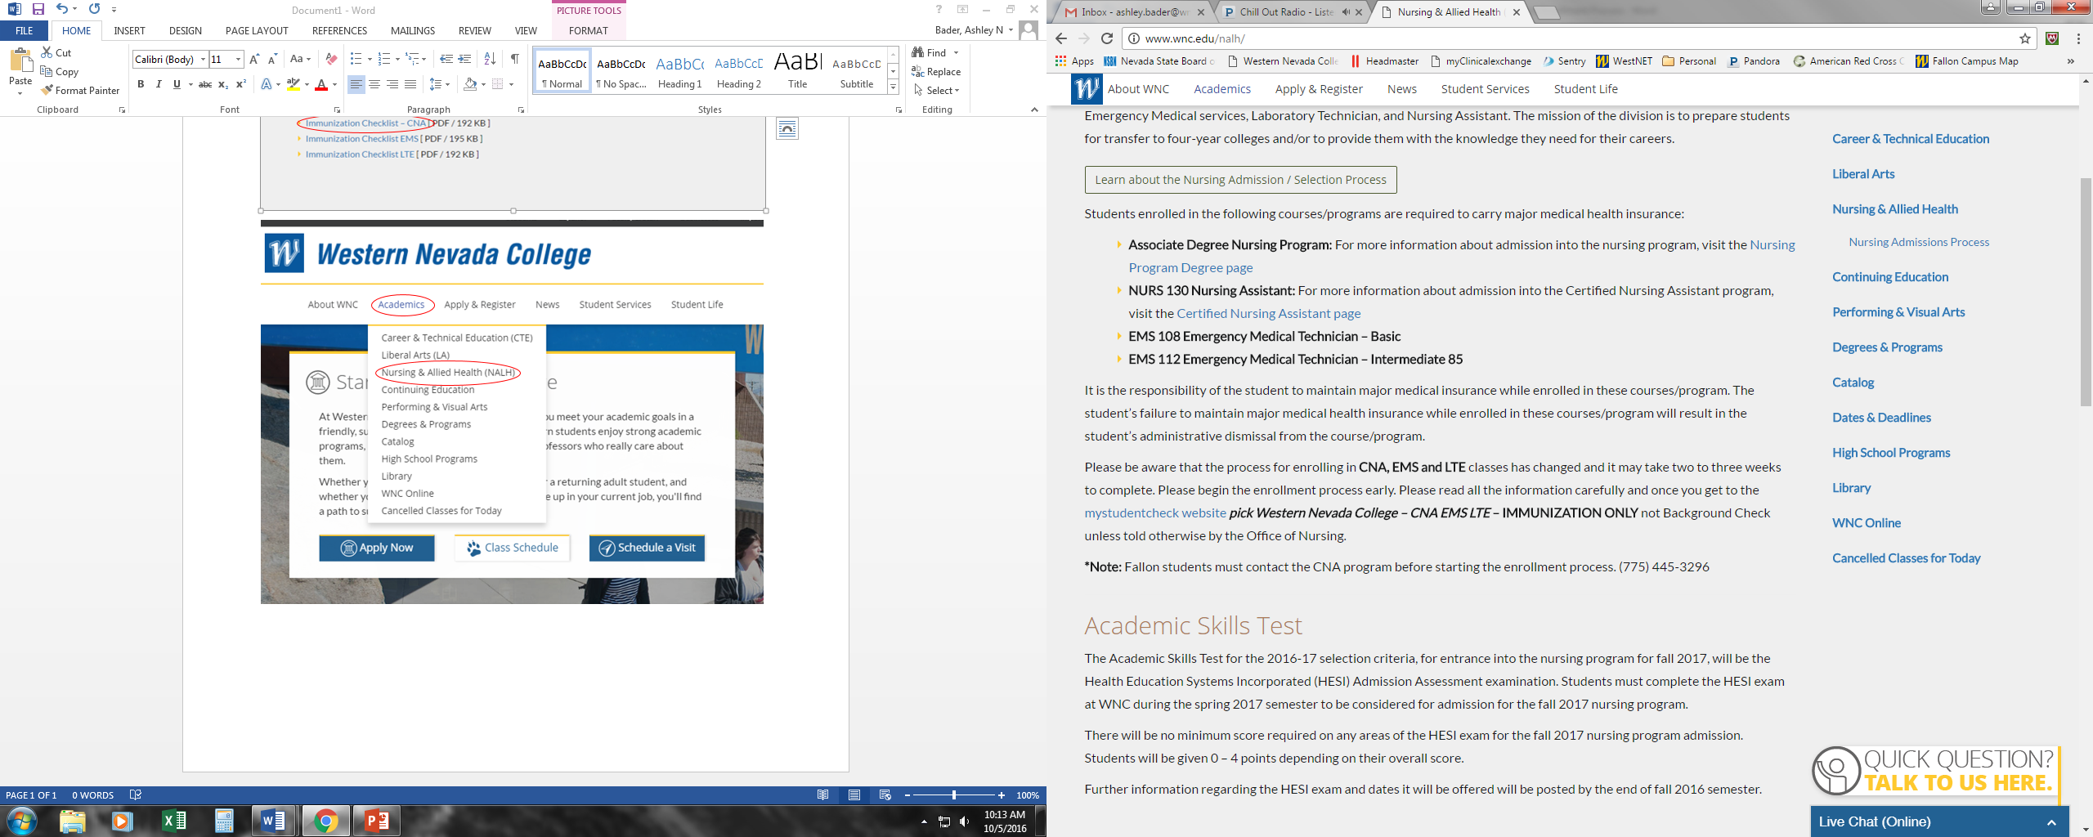

Slide 10
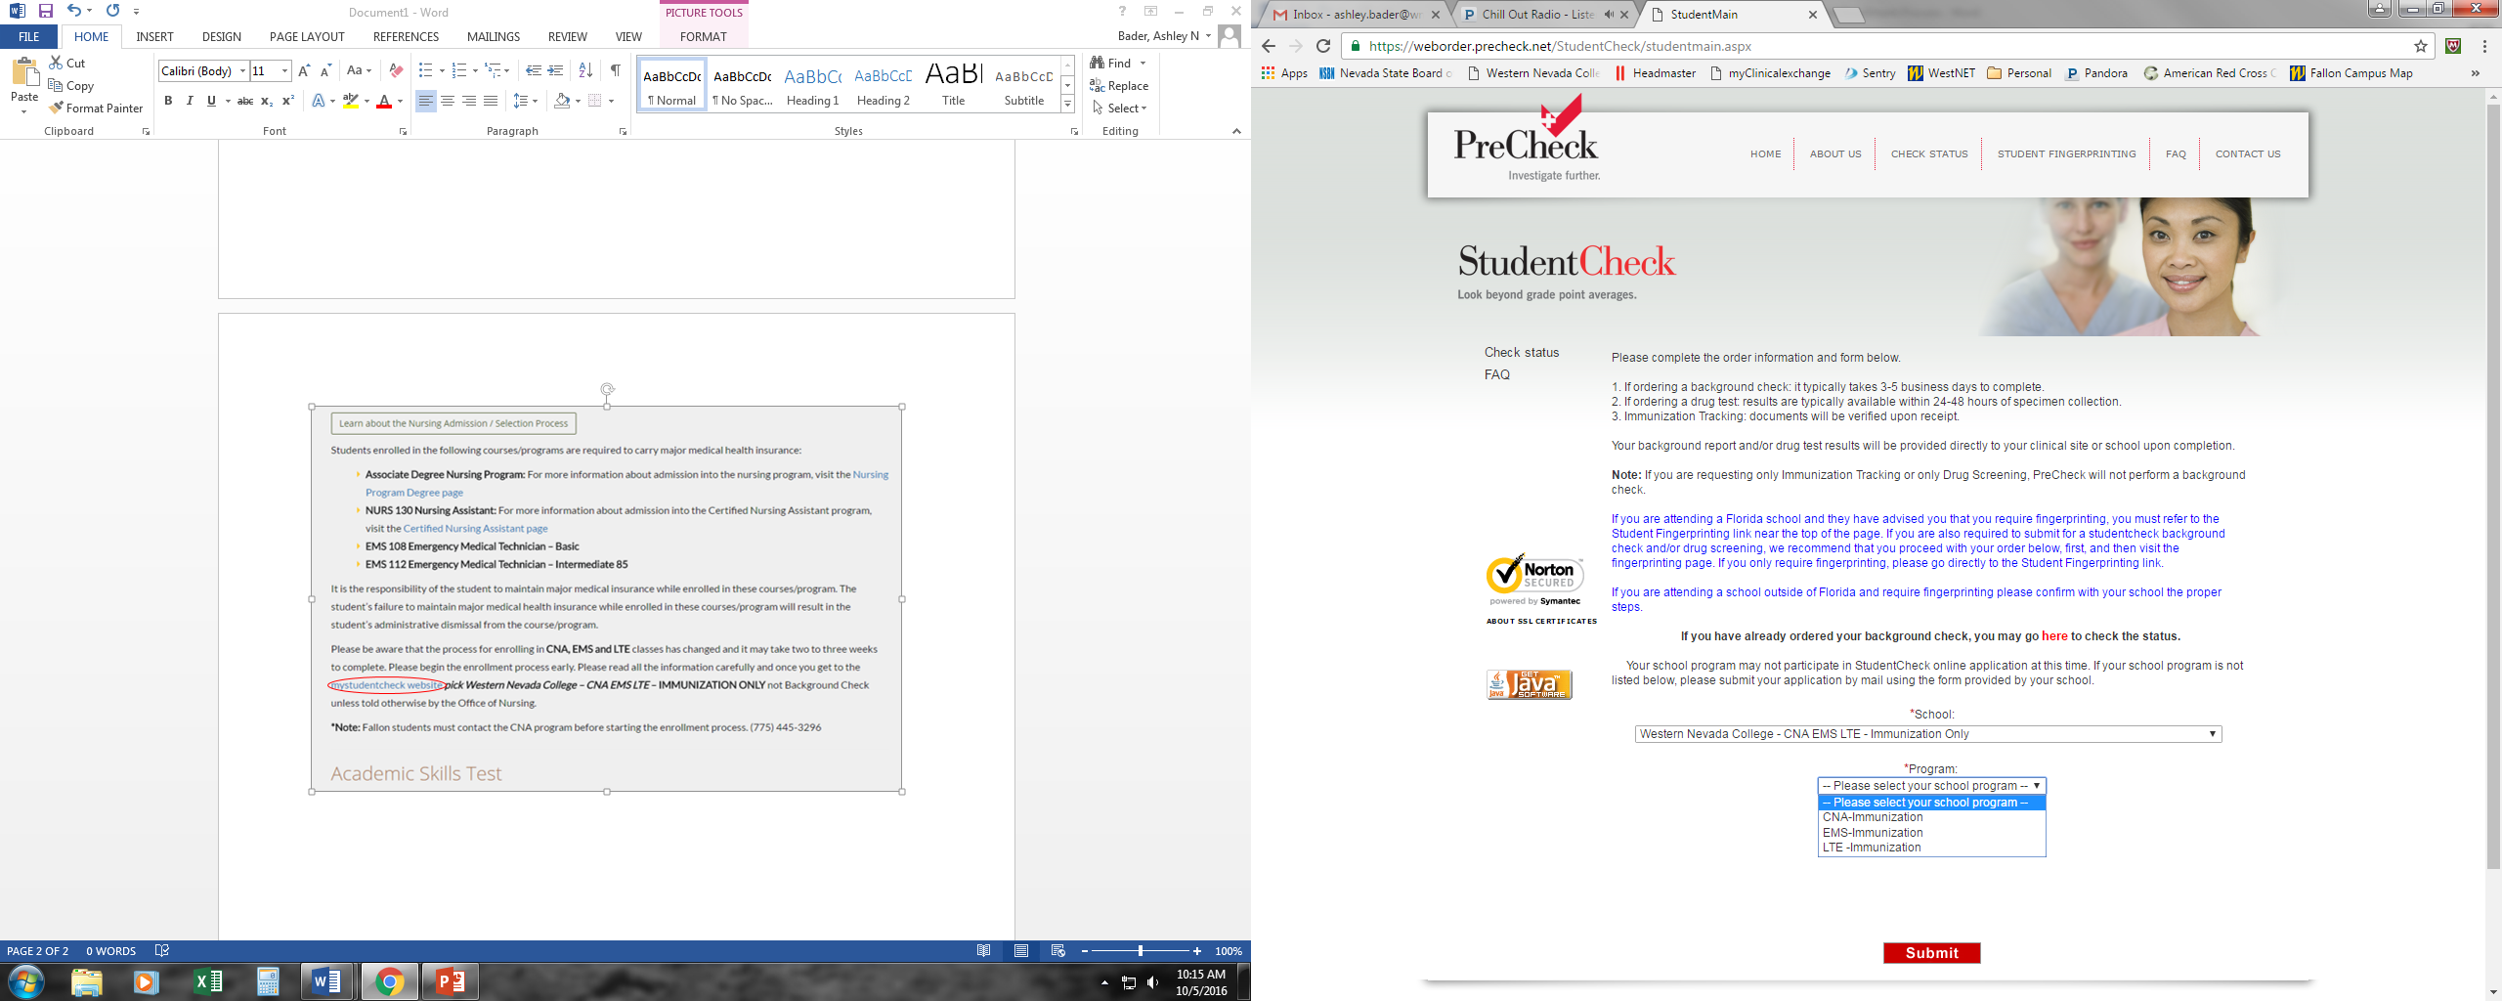

Slide 11
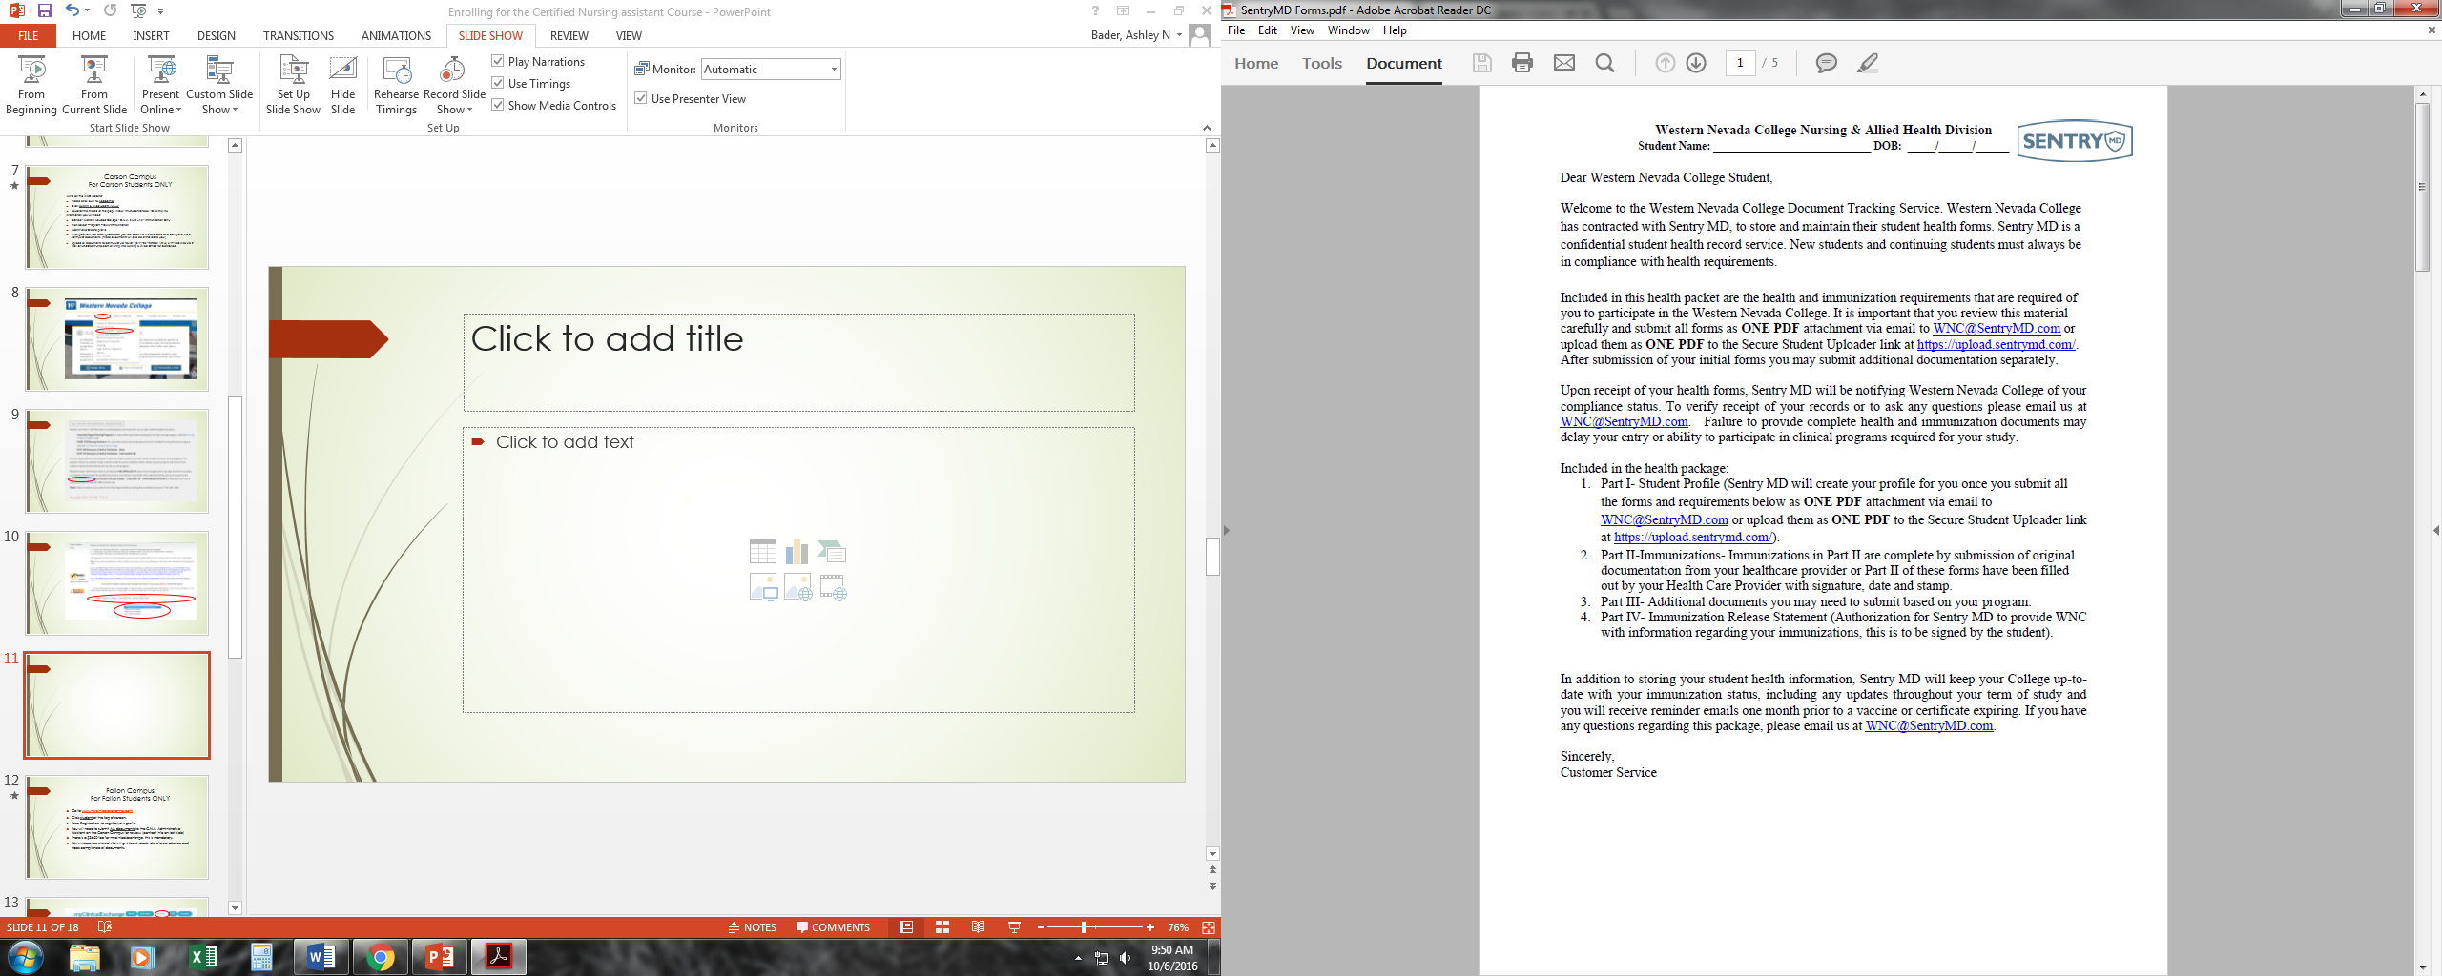
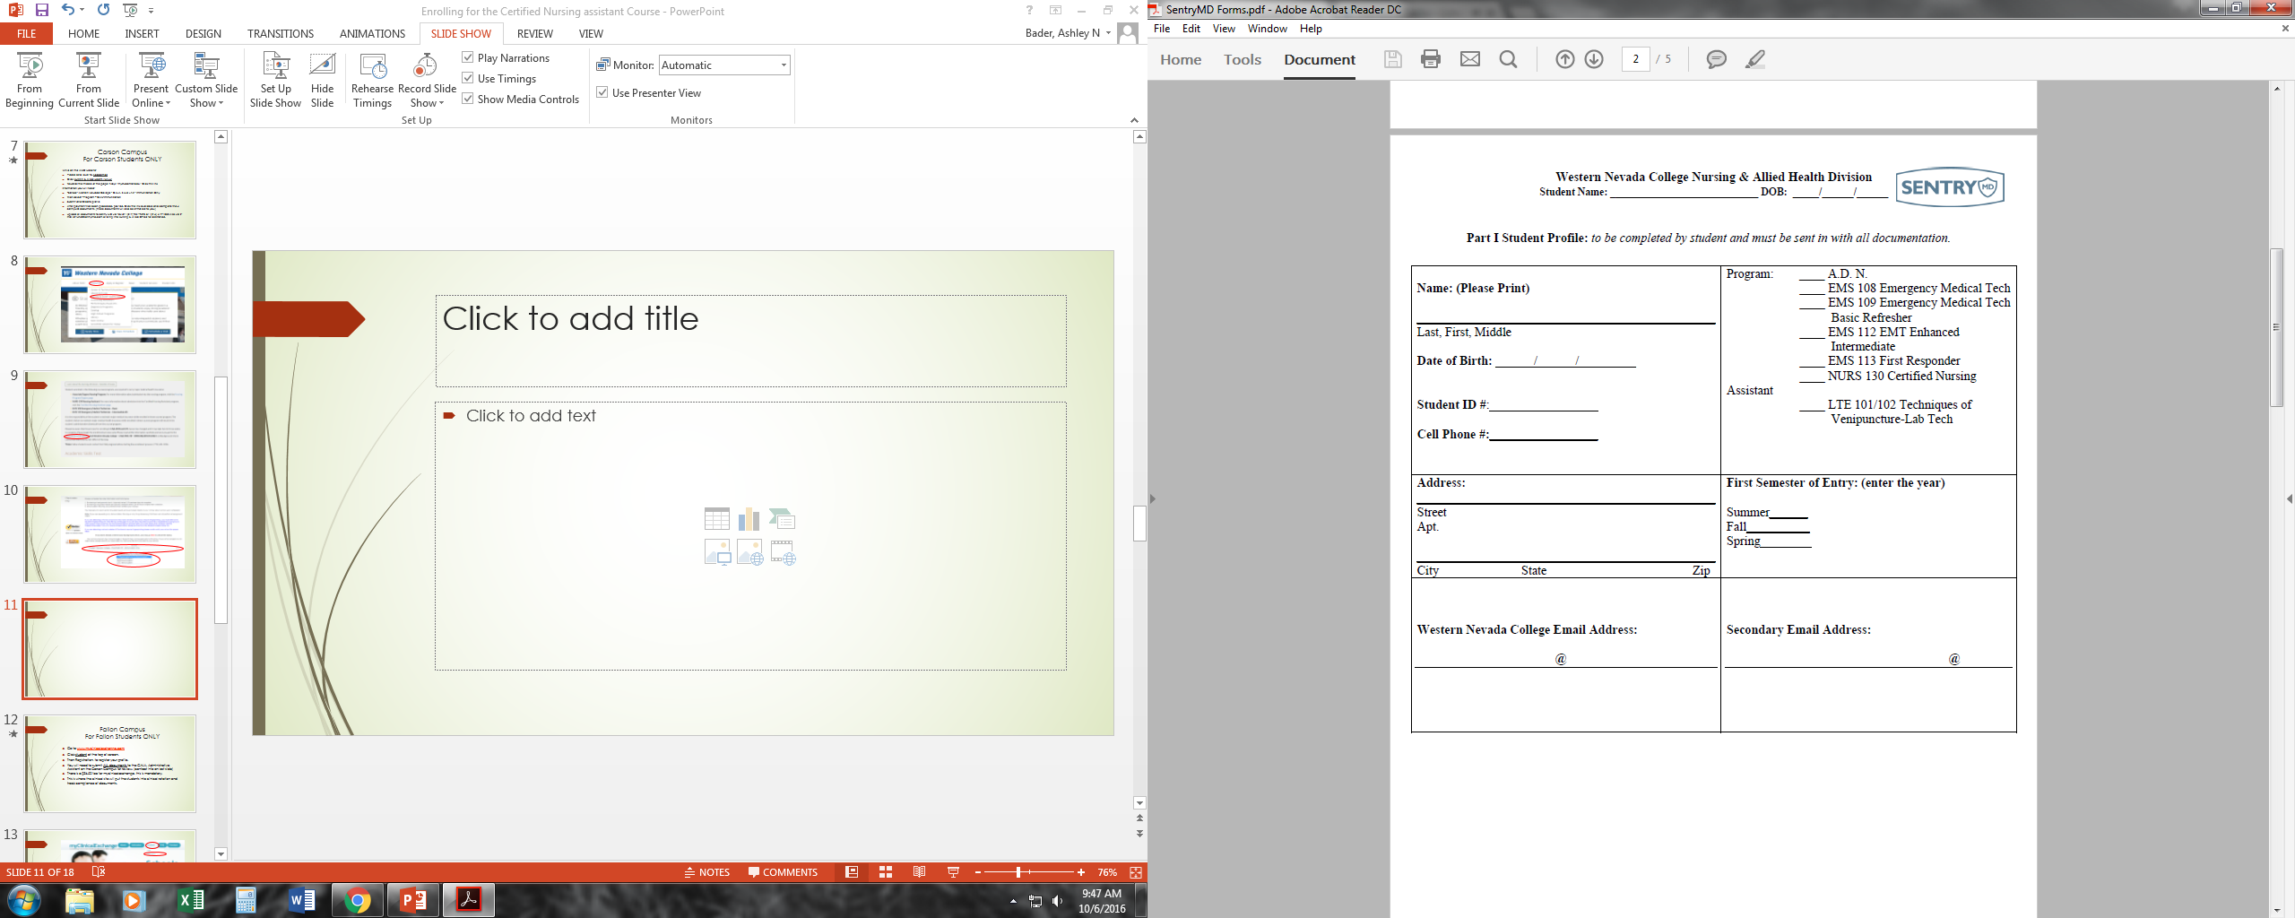
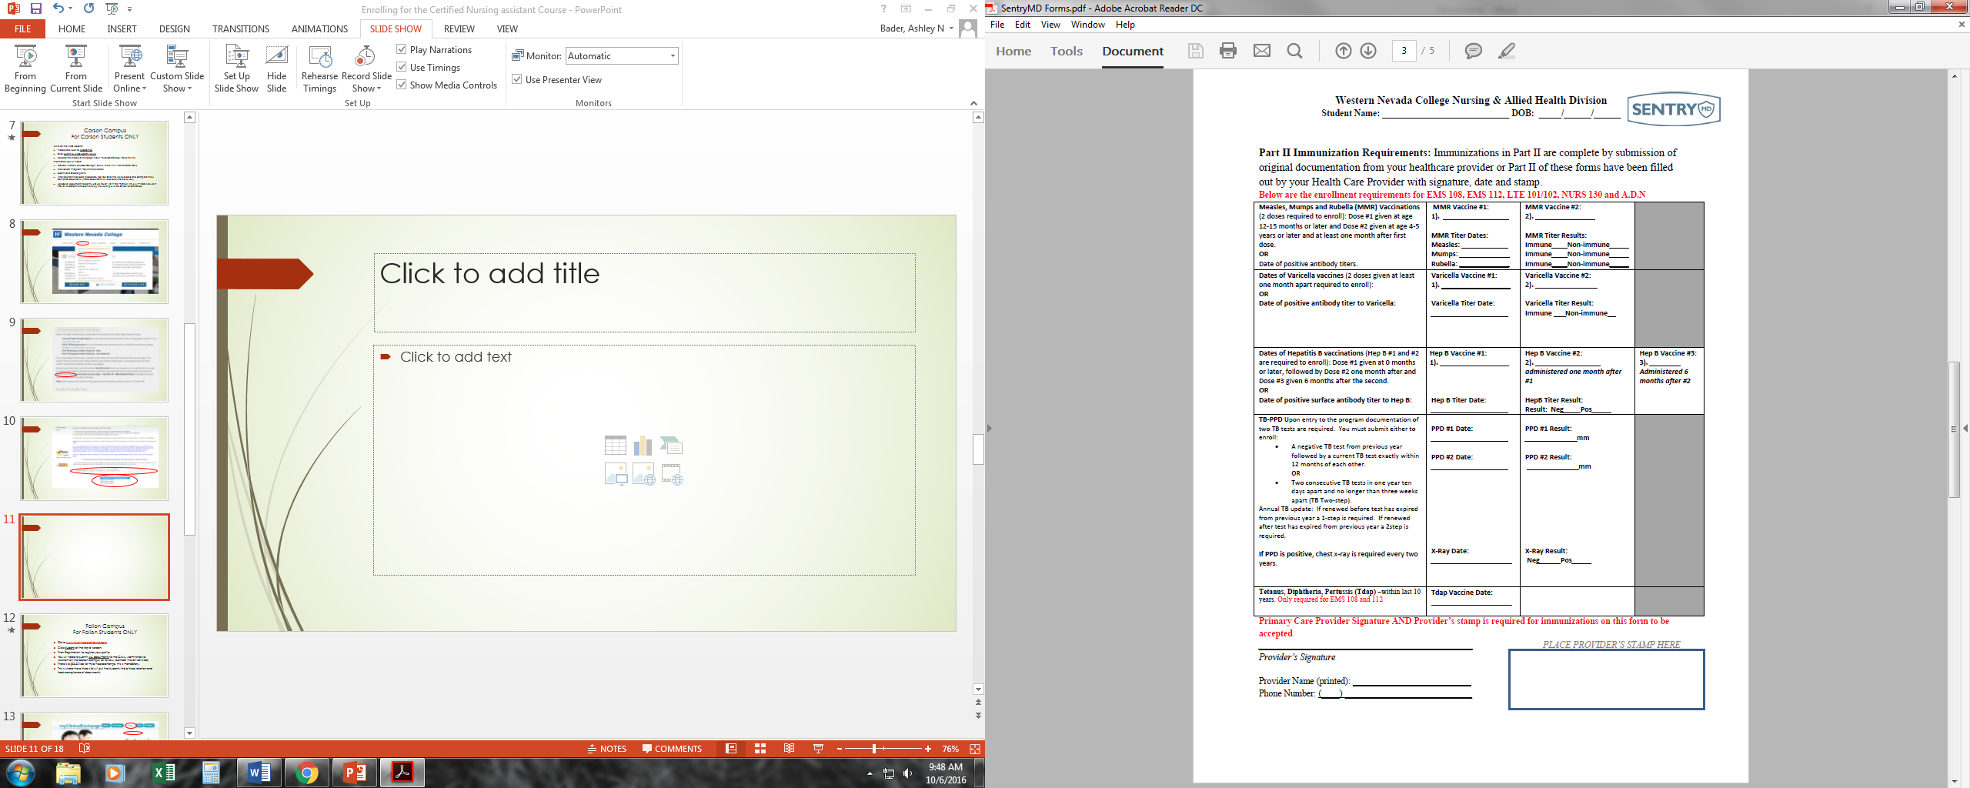
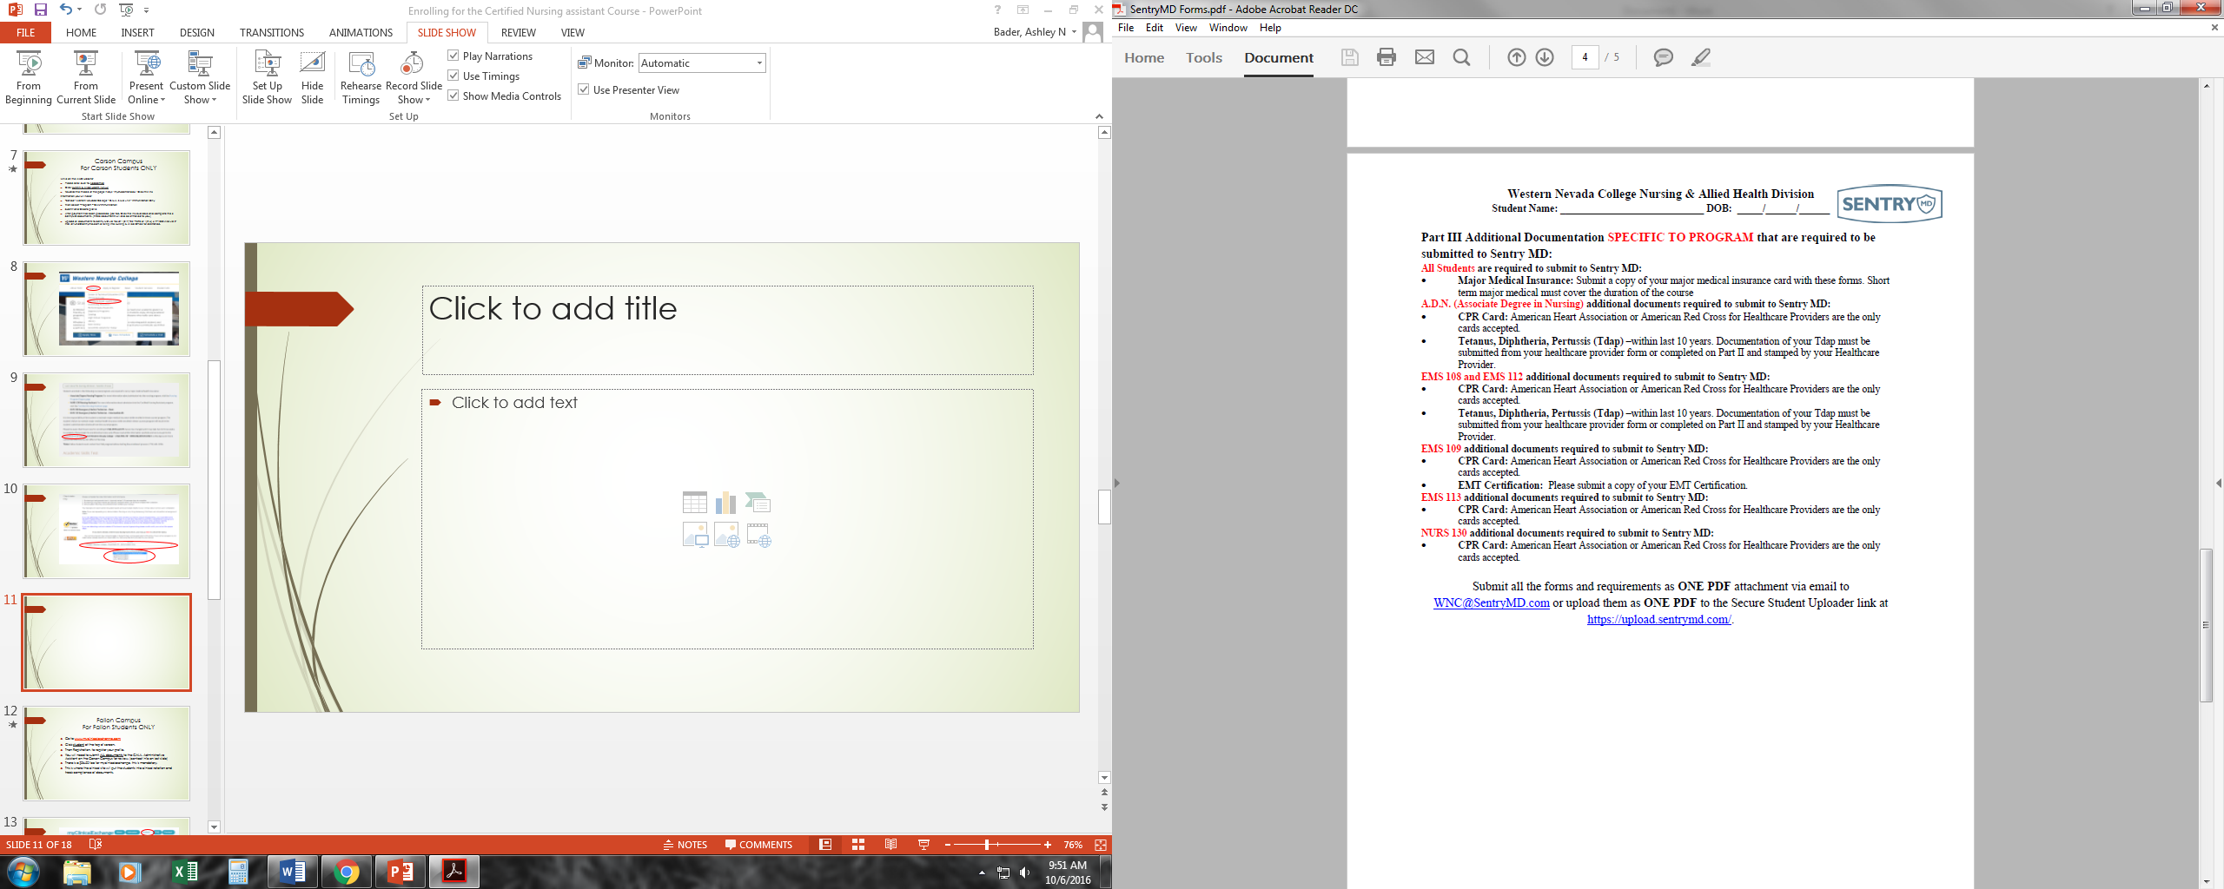
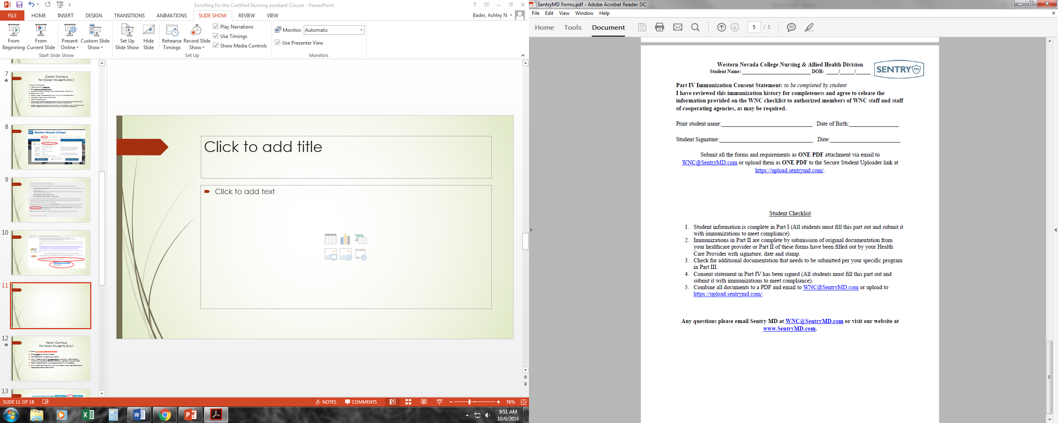
Fill out completely
Name & D.O.B
If you have copies of your vaccines you do not need to fill out this form.
Name & D.O.B
Print, Sign, D.O.B & Date

Slide 12
After all documents have been submitted
SentryMD(studentcheck) will confirm receipt of all documents to the office of Nursing and Allied Health.
You will then be released to enroll, you will be informed of the class# by email. It is important that you make sure your email address is correct in your MyWnc account.
For current fees please visit www.wnc.edu under Apply & Register, Click Fees, Payments & Refunds.

Slide 14
Additional Information
If you have applied for financial assistance or plan to make payments, it is strongly advised to make sure the Financial Assistance Office has flagged your account. If your account is not flagged you may unintentionally be dropped from the class for non-payment.
Drop dates for non payment will occur the Friday Prior to the beginning of the semester and two weeks after class has started. Unless arrangements have been made through Financial Assistance.
Please make sure all paperwork is submitted at least 4-6 weeks prior to the beginning of the semester to ensure adequate time for paperwork to be processed.

Slide 15
Notice
Please see your syllabus for attendance policy, required lab and Clinical hours.

Slide 16
Contact Information
For questions, comments or concerns: Please contact the Nursing & Allied Health Office at the Carson City Campus:
2201 W. College Parkway
Carson City 89703
Cedar Building Room 101
Cheryl Bartels - Administrative Assistant
Via phone (775) 445-3294
Via Fax (775) 445-4443
Via E-mail at Cheryl.Bartels@wnc.edu

