Slide 1
Serving Those Who Served
Welcome to Western Nevada College
Trent Whitney

Slide 2
Incoming Veteran Checklist
The Questions
Meet with Coordinator
Apply for Western Nevada College
Apply for benefits
Meet With an Academic Advisor
Disability Support Services
Vet Data E-from
Supply documents
Certificate of Eligibility
DD-214 MEMBER 4 COPY
Joint Service Transcript
Petition for WNC JST
Fill out FAFSA/Scholarships

Slide 3
The Questions
What degree plan are you going for?
This is critical information for allotted time of the 9/11 or GI bill (48 months). The nursing program takes EXACTLY that long.
Is your degree plan available?
What benefits are you using?
CH 30 Montgomery GI bill.
CH 31 VR&E (disability percentage is anything over 10% allows use of VR&E over chapter 30/33).
CH 33 post 9/11
CH 35 Dependents

Slide 4
Meet VRC Coordinator
Veterans Resource Center Cedar Building, Room 300 2201 West College Parkway, Carson City, NV 89703 Deb Conrad, Veterans Resources, Prison Education and Apprenticeship Program Director deb.conrad@wnc.edu 775-445-3301

Slide 5
Apply to WNC Click to apply: Western Nevada College
Click apply

Slide 6
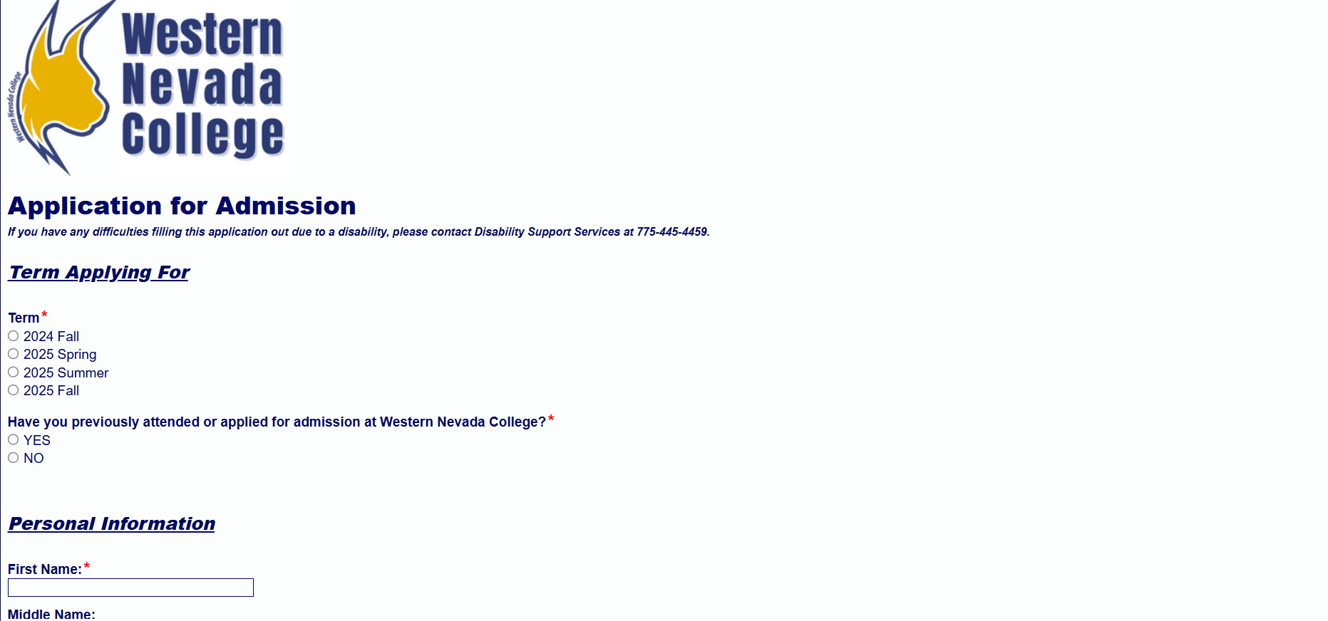
Apply to WNC
Have students fill out info. It can take 3-5 business days before they get their student ID

Slide 7
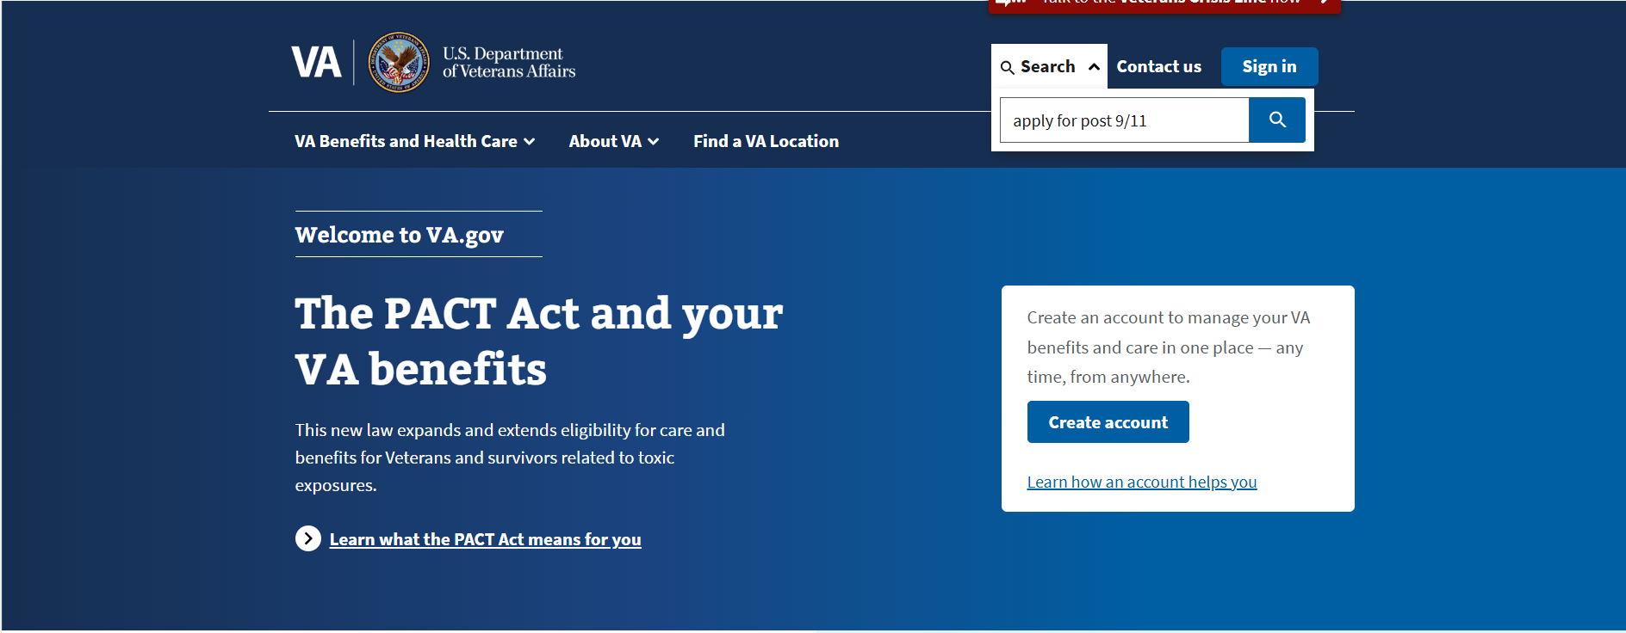
Apply For Benefits
CH33: POST 9/11 How To Apply For The GI Bill And Related Benefits | Veterans Affairs
CH 30: Montgomery Gi bill: How To Apply For The GI Bill And Related Benefits | Veterans Affairs CH 31:VR&E Eligibility For Veteran Readiness And Employment | Veterans Affairs CH 35: Survivors’ And Dependents’ Educational Assistance | Veterans Affairs

Slide 8
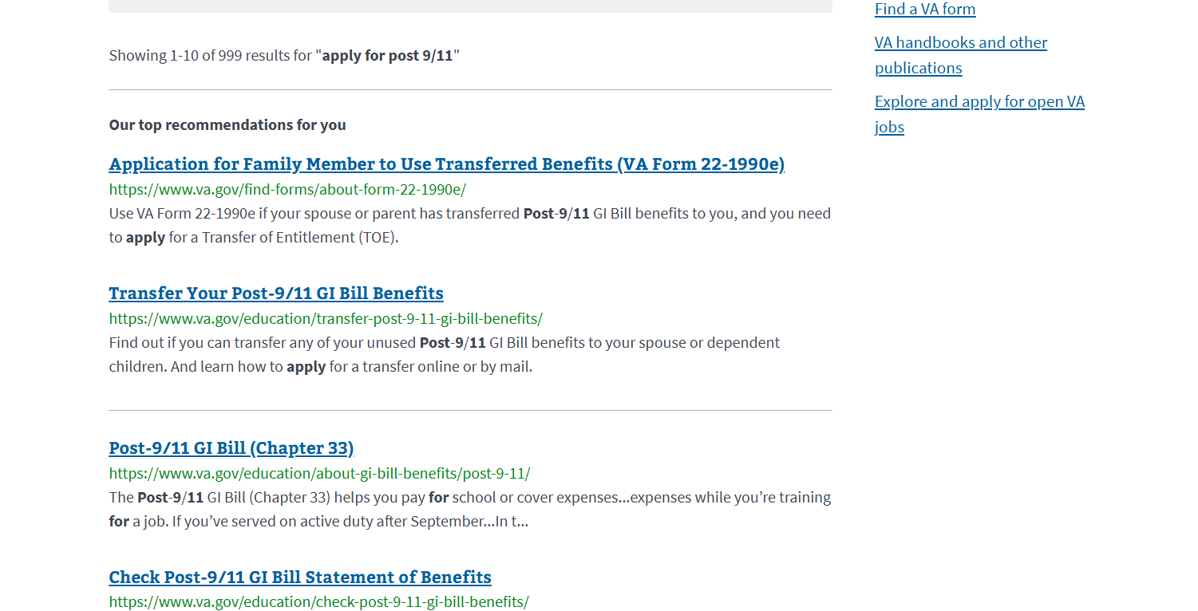
Apply For Benefits

Slide 9
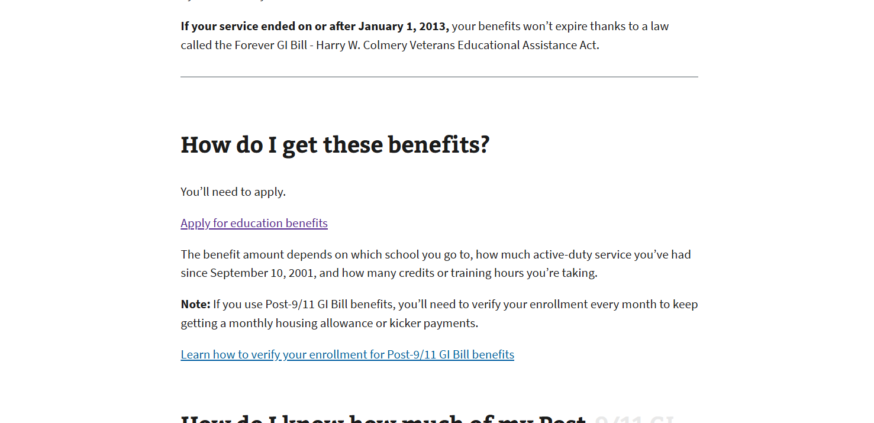
Apply For Benefits

Slide 10
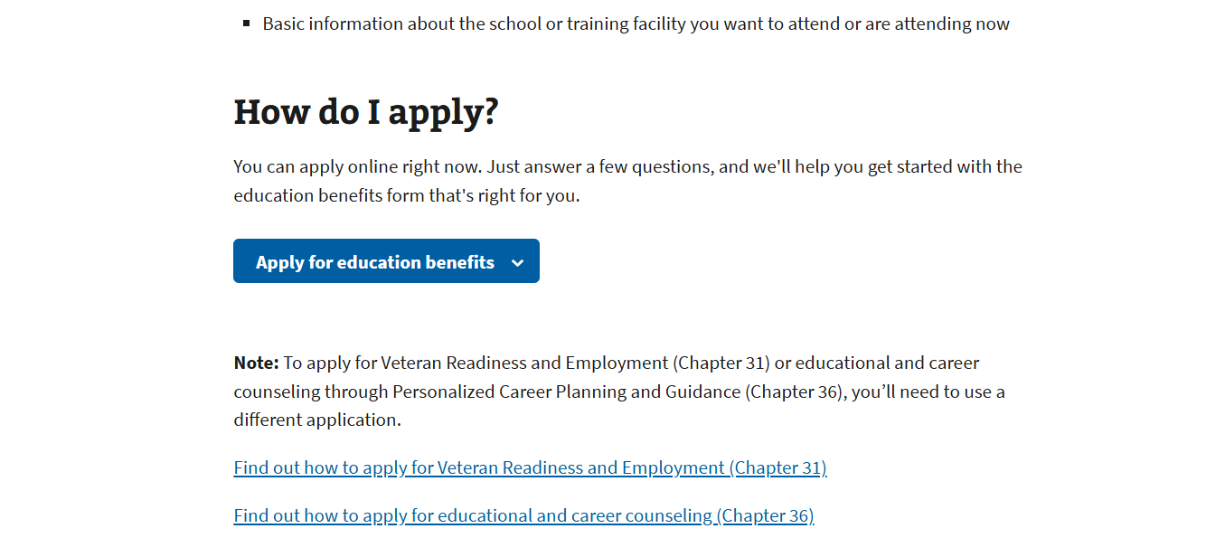
Apply For Benefits

Slide 11
Apply For Benefits
The process for VR&E and CH 35 are similar just search the one you’re looking for

Slide 12
Meet with an academic advisor click to schedule
Academic Advising and Access

Slide 13
Complete Veterans Data-E Form
Must be done every semester.
Must know the degree the student is seeking to be filled out.
This is the only way Western Nevada will know that you want to use your benefits!
Must meet with an academic advisor to finalize! Academic Advising and Access

Slide 14
VET Data-E Search or Click:
Veterans Data Form CLICK ME!
Type veteran

Slide 15
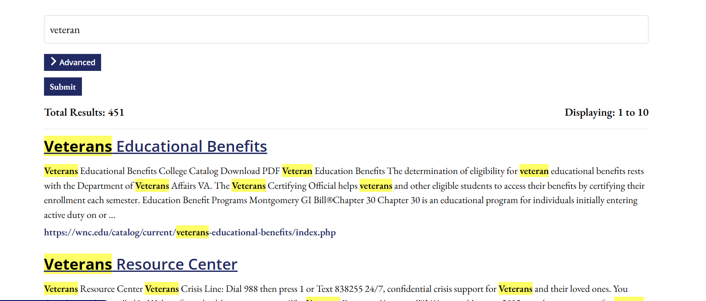
Vet Data-E

Slide 16
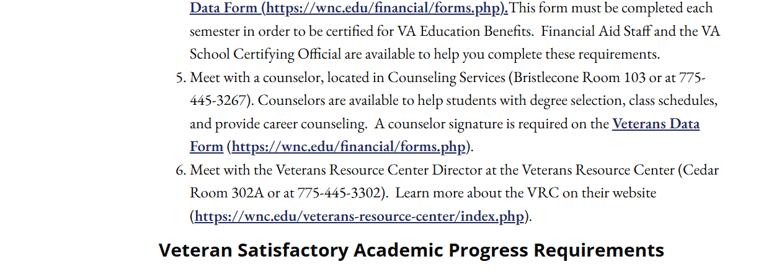
Vet Data-E

Slide 17
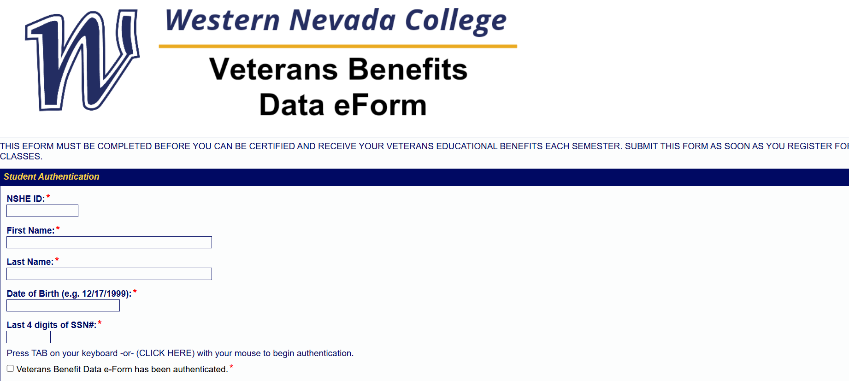
Vet Data-E Form

Slide 18
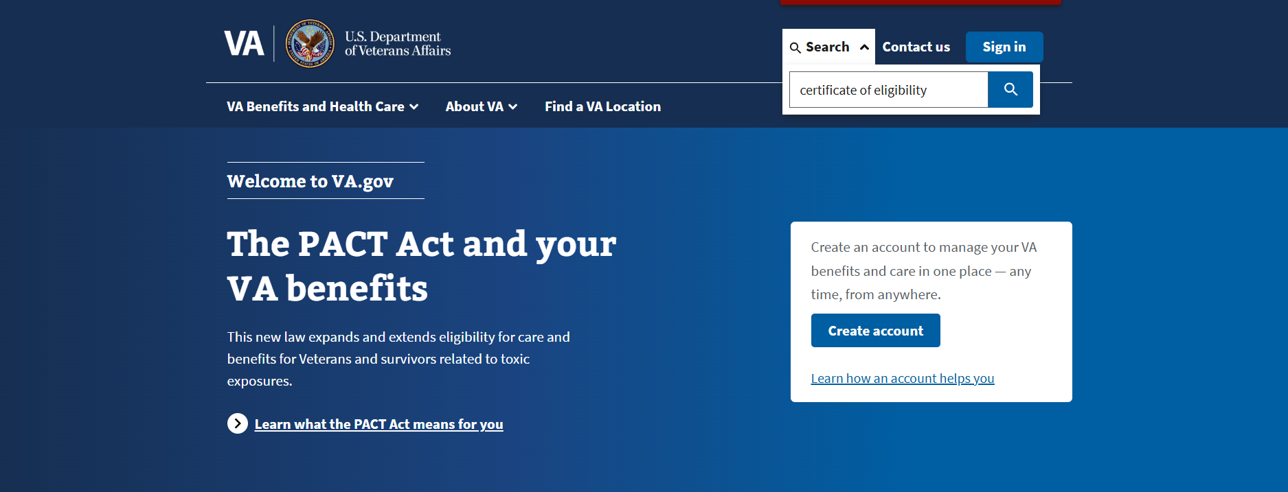
COE search or click
Can I Get A Copy Of My Education Decision Letter? | Veterans Affairs
Search

Slide 19
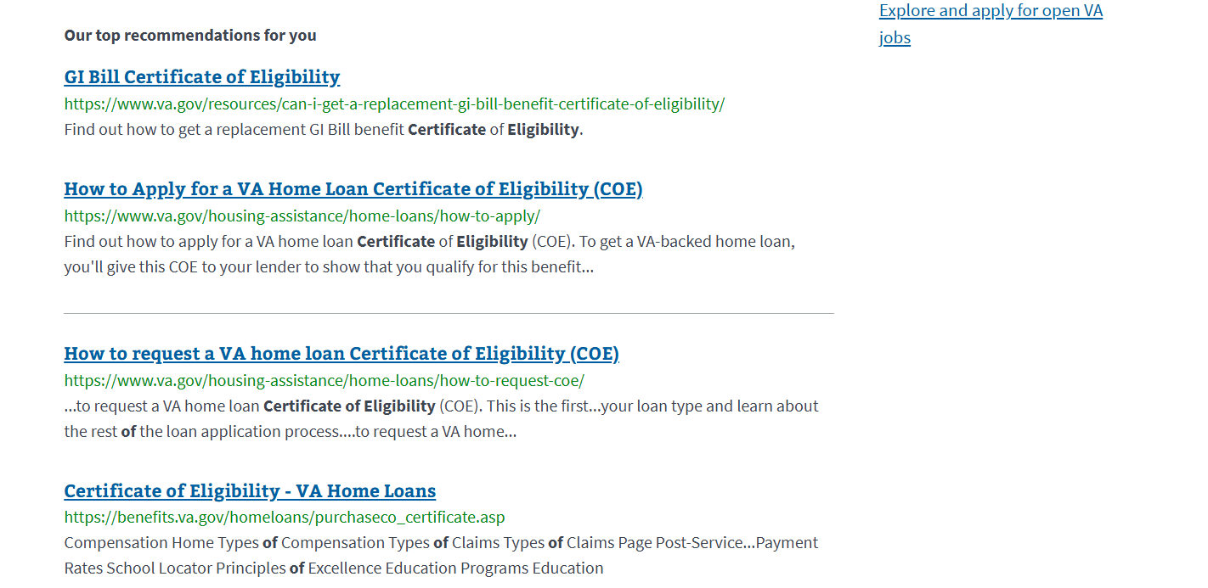
COE

Slide 20
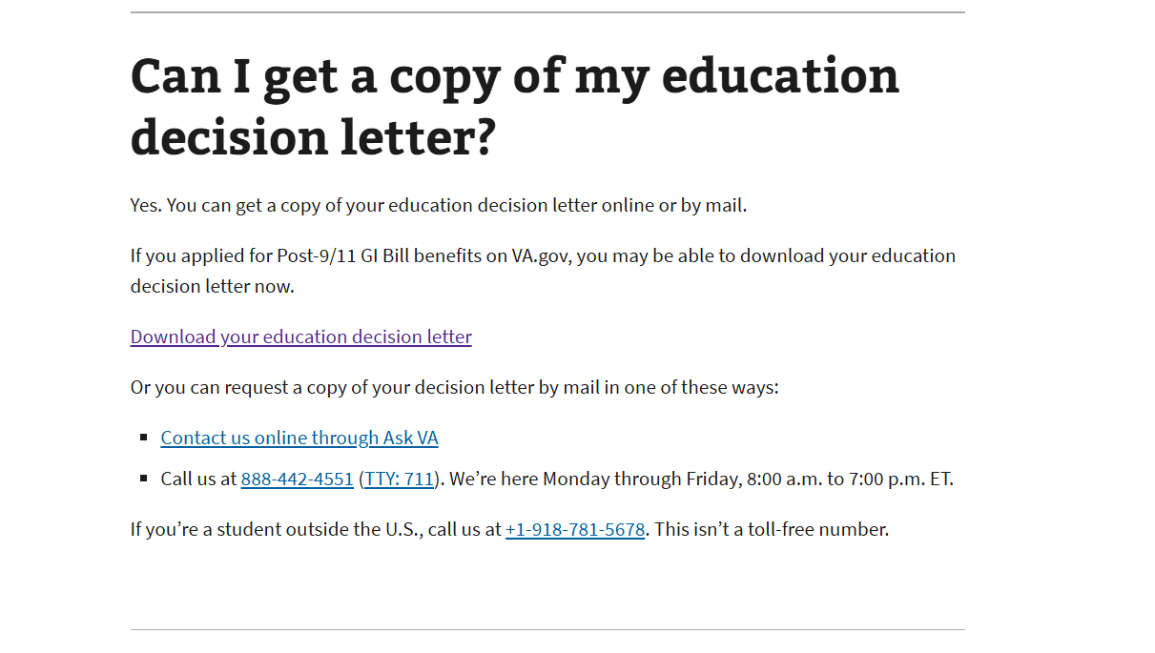
COE

Slide 21
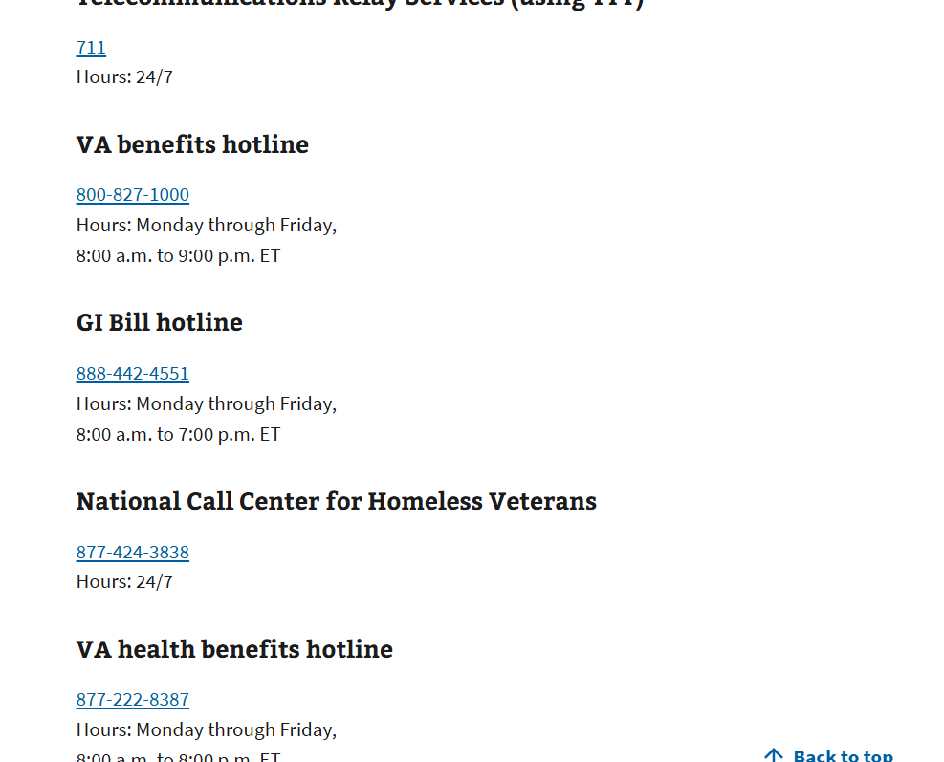
DD-214 MBR 4
You can call the VA to get a copy if they lost it:

Slide 22
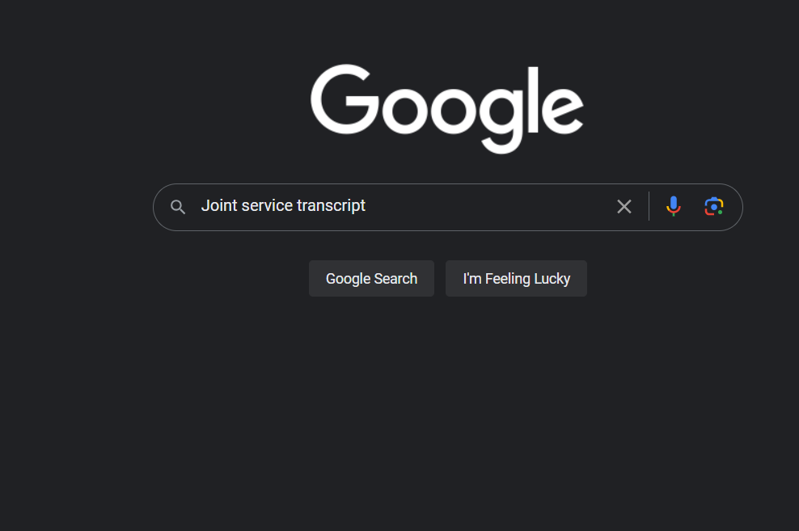
JST google or click:
Home page

Slide 23
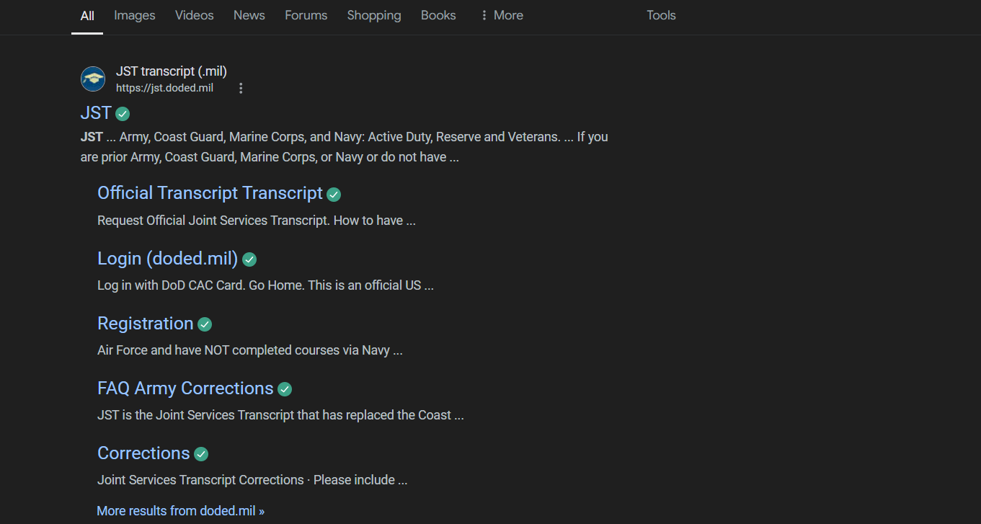
JST

Slide 24
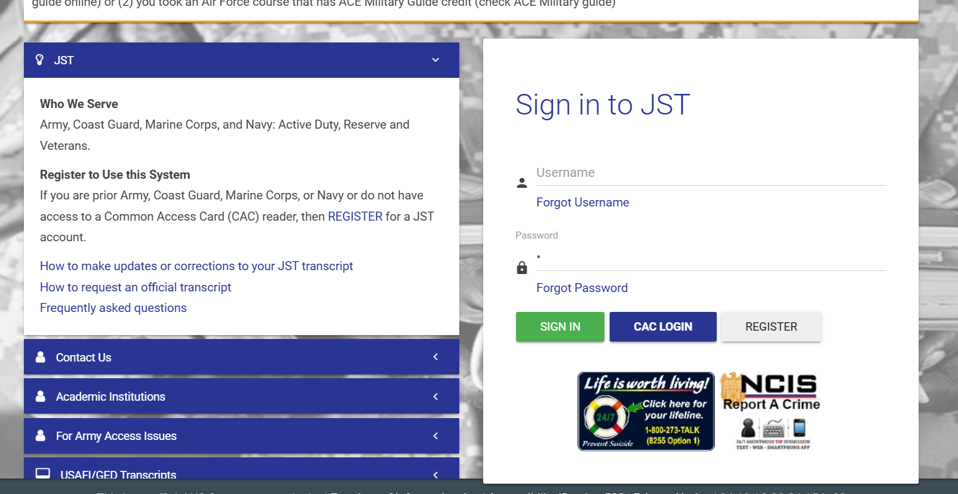
JST

Slide 25
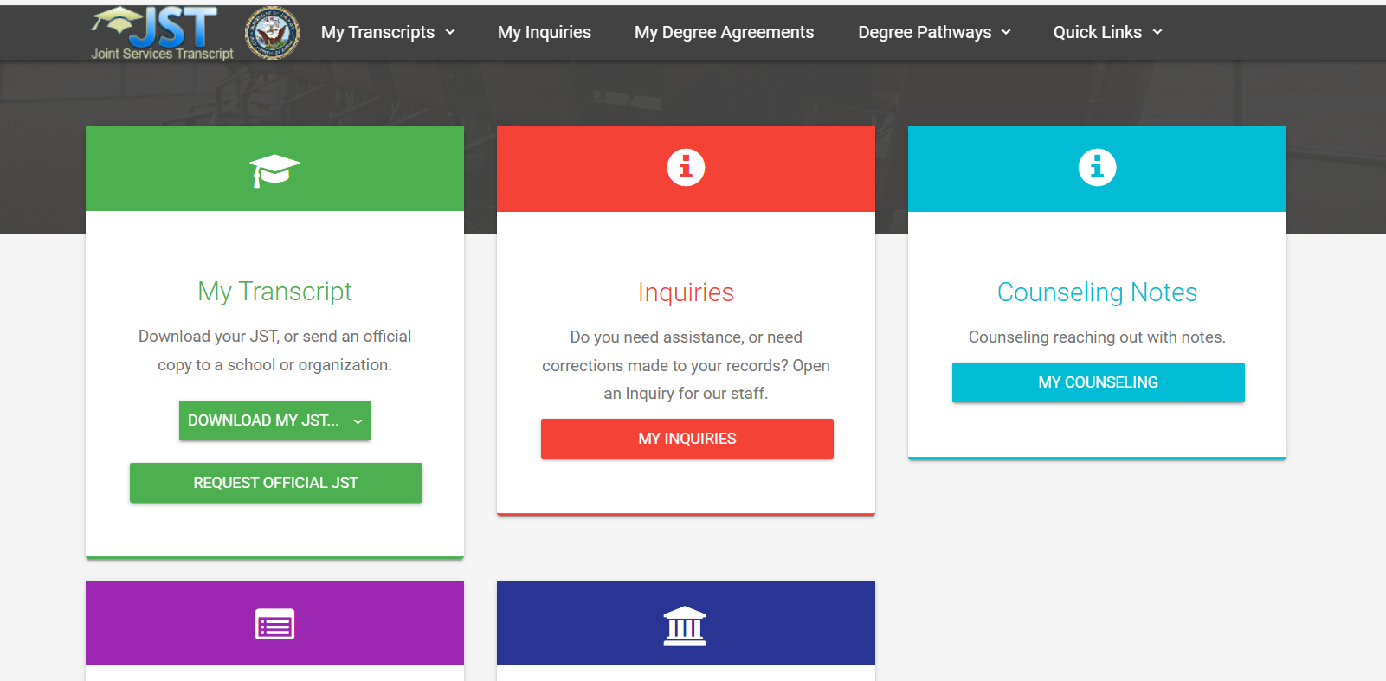
Click to request an official transcript

Slide 26
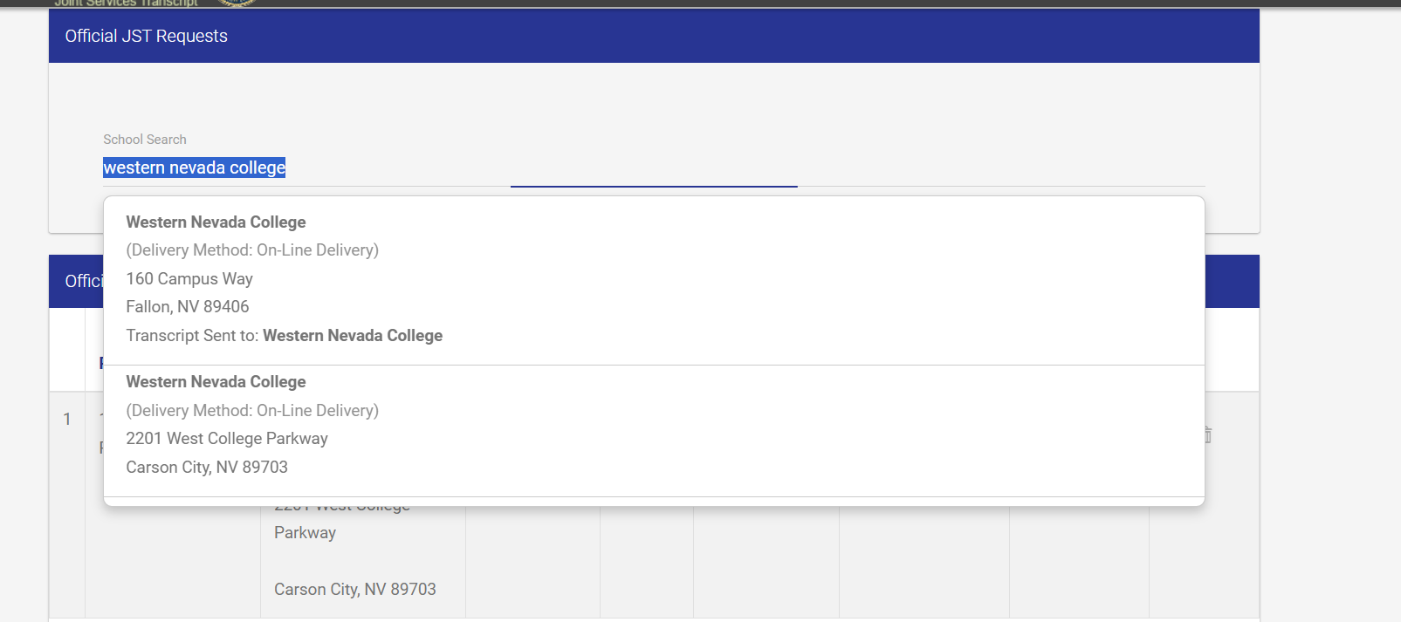
Type Western Nevada College Select Carson/Fallon Campus

Slide 27
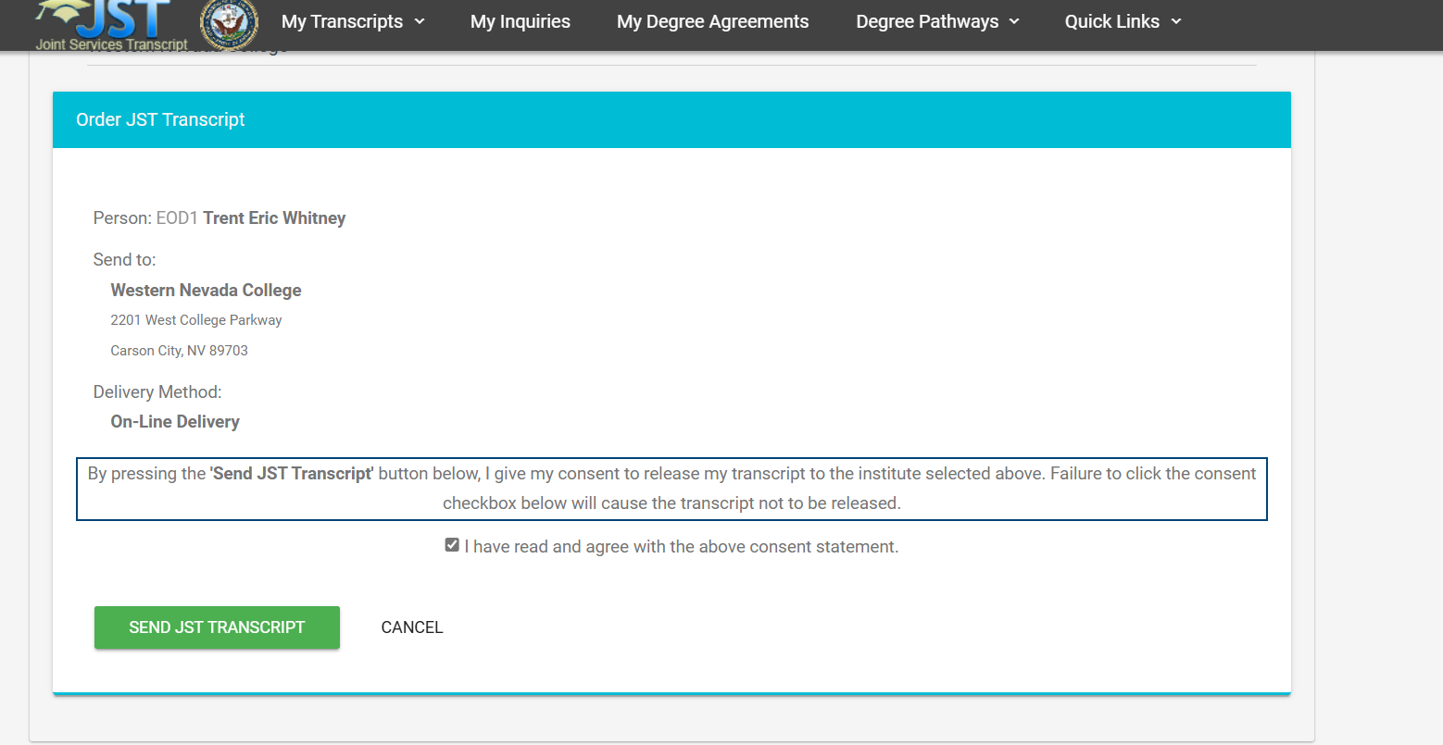
Click agree and send JST transcript

Slide 28
Petition search or click:
Petition for Transfer Credit Evaluation
Type veteran

Slide 29
Petition

Slide 30
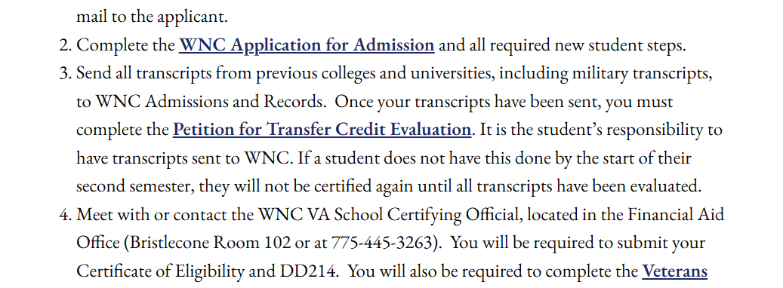
Petition

Slide 31
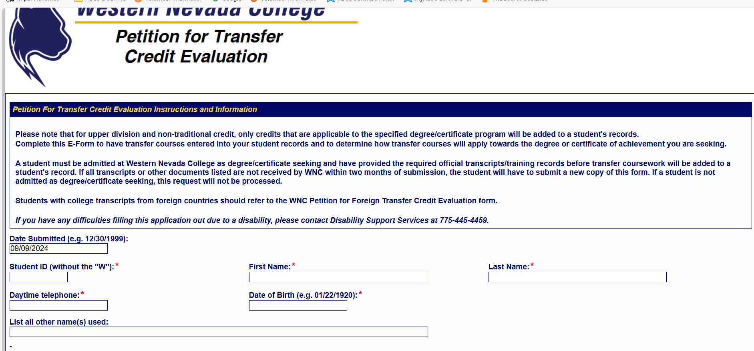
Petition

Slide 32
FAFSA and Scholarships
Financial aid under student services. Highly recommend this plus other scholarships for those hurting for coin.
FAFSA® Application | Federal Student Aid
Scholarships and Types of Financial Aid

Slide 33
Disability Support Services
If you have a qualifying disability some accommodations can aid you! Click the link to read more.
Disability Support Services

Slide 34
Welcome To Western Nevada!

